Slide 1


3D ultrasound tutorial with Slicer 3D and PlusServer
Tutorial written by Aurélie SARCHER, Research Engineer
Aurelie.sarcher@gmail.com
Laboratory Movement, Interactions, Performance UR4334, Nantes Université
Version dated 20/12/2023

Slide 2
0 INSTALLATION

Slide 3
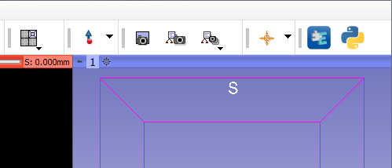
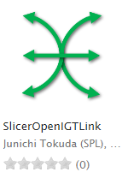
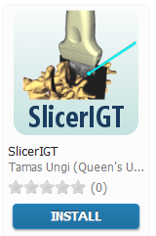

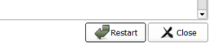
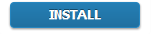
Installation of Slicer extensions
Installation of Slicer
Install Slicer 3d (tutorial tested with version 4.11.0 dated 24/08/2020)
1.
Open the ‘Slicer Extension Manager’
Click on ‘Install’ for the following extensions :
SlicerOpenIGTLink
SlicerIGT
SlicerIGSIO
Restart Slicer
3.
2.

Slide 4
1.1 CAREFUL !

Slide 5
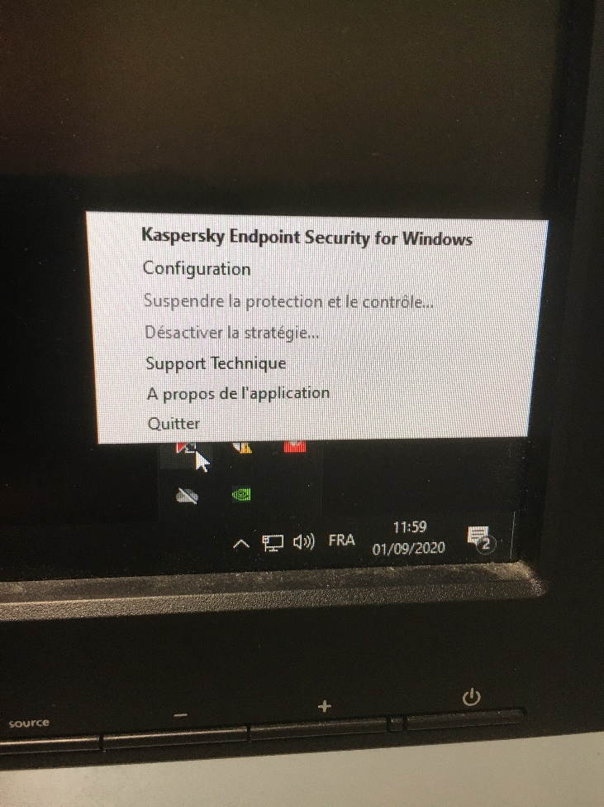
First step before anything
Quit Kaspersky, which blocks the video streaming of the ultrasound
Plug the frame grabber CAM LINK 4K and both USB plugs from the Optitrack cameras to USB 3.0 plugs (the blue ones).
Possible bug linked to the sync RCA cable of the Optihubs: only half the cameras are recognized or instead of begin numbered from 1 to 11, the cameras are numbered with duplicate numbers (1-1, 2-2, 3-3, etc.). If this is the case, try adjusting the RCA cable.

Slide 6
1.2 OPTITRACK CALIBRATION

Slide 7
When to do it ?
If the cameras have been moved …
Recommendation : do it everytime
I have already calibrated the Optitrack system ?
Load the calibration into Motive and
Go to Slide 11

Slide 8
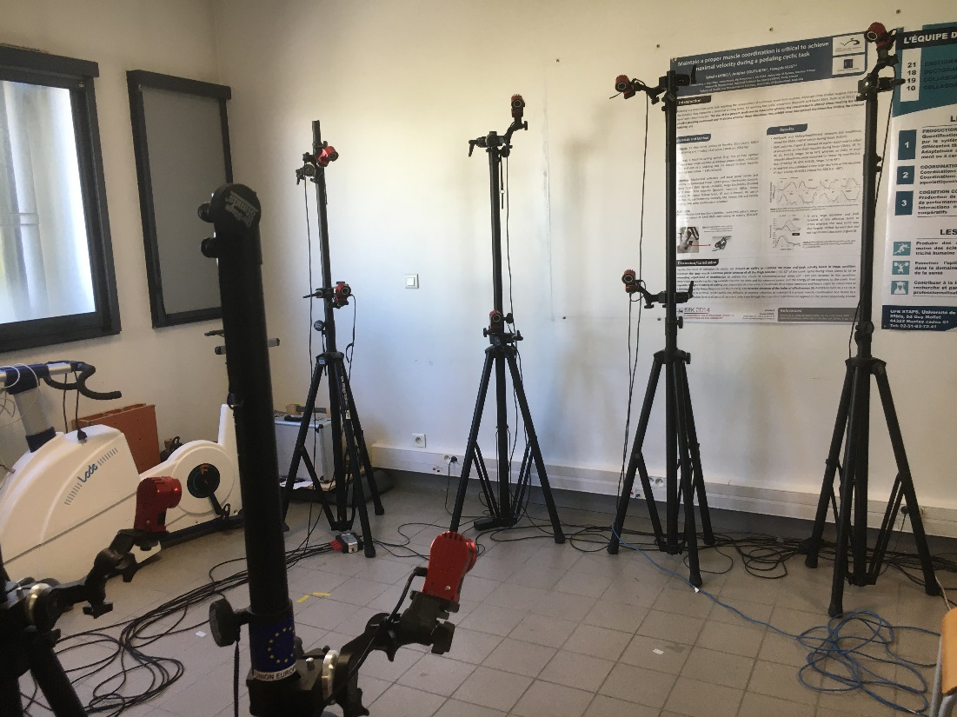
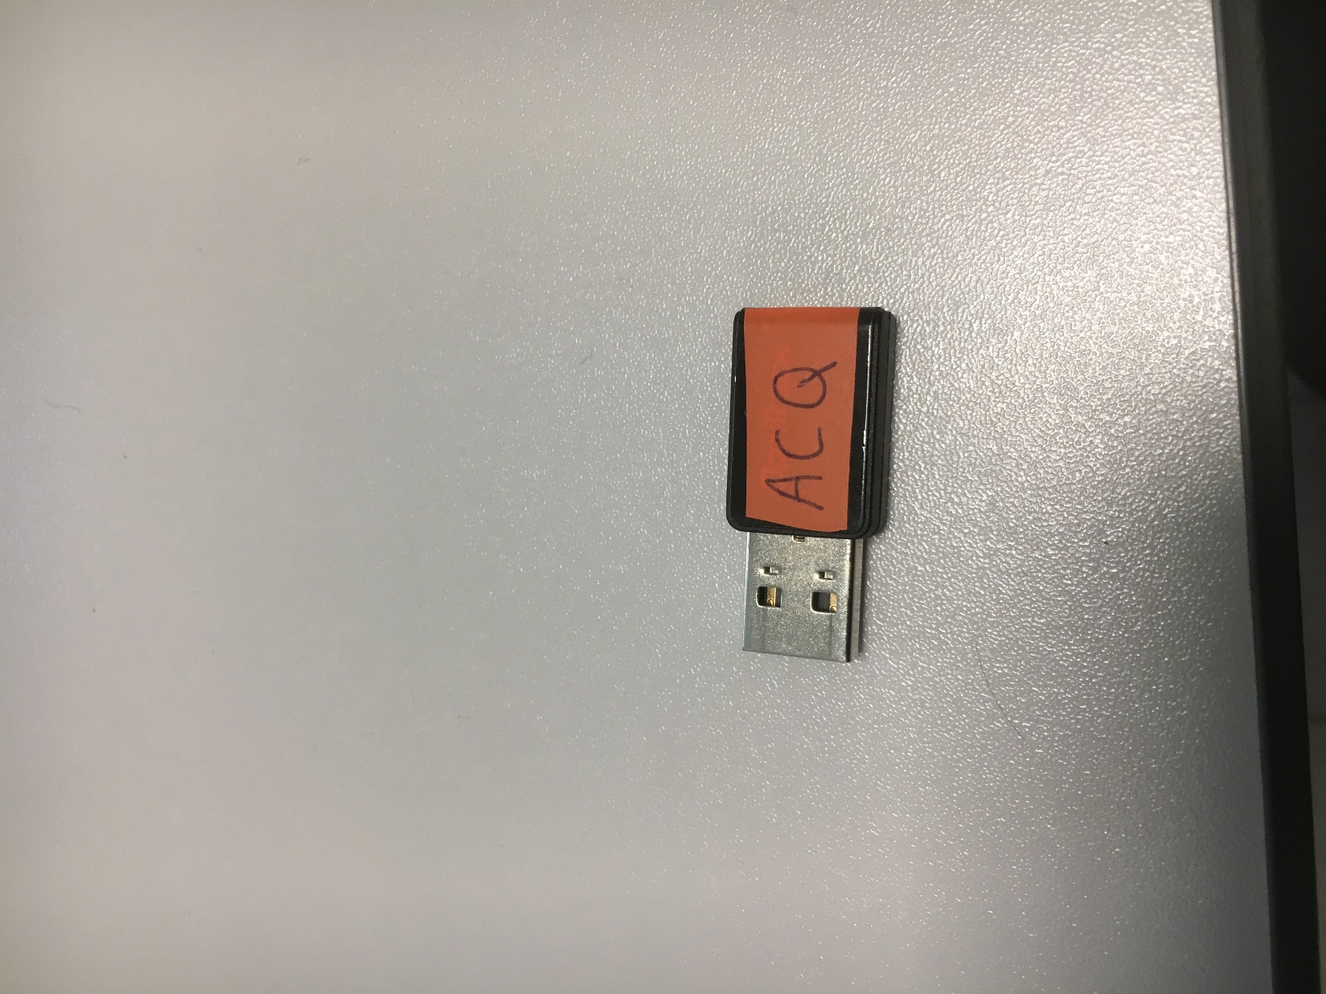
OPTITRACK –MOTIVE SOFTWARE
Prepare the cameras and the capture volume
Start Motive software with the USB key ‘ACQ’

Slide 9
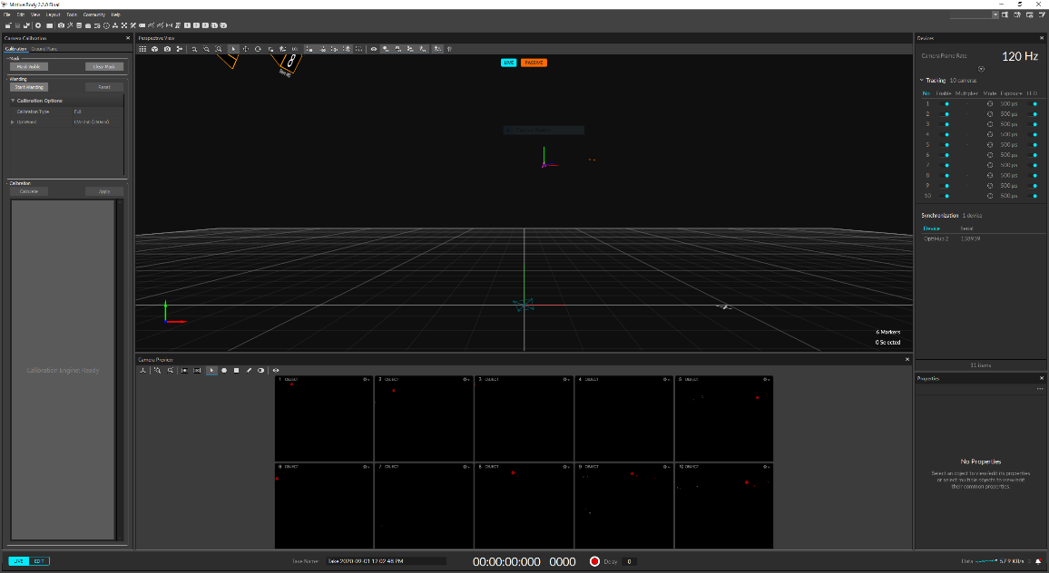
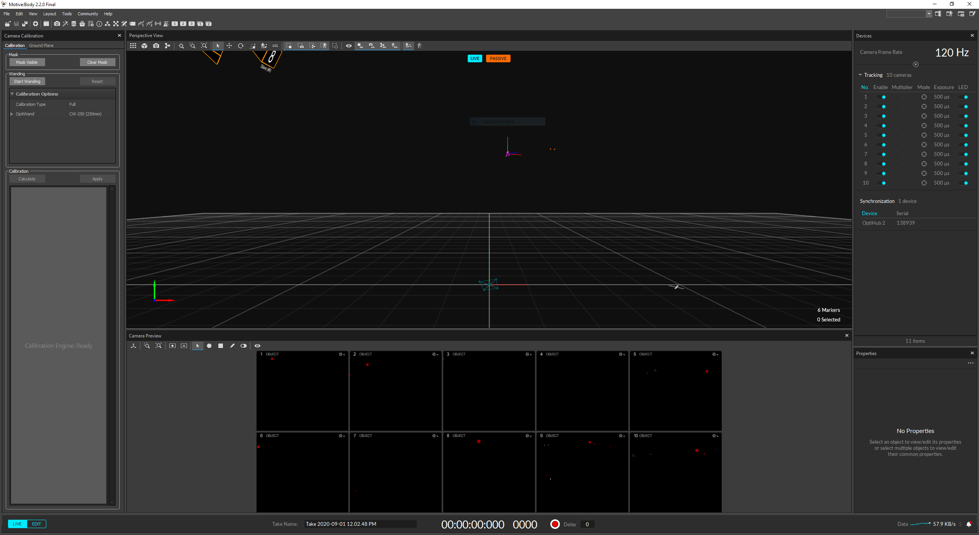
Choose ‘Perform camera calibration’
Set the camera settings :
Exposure : 200 microseconds
Threshold : 250
Add a folder ‘File’ → ‘add session folder’ and create a new session folder.
(Verify that no asset is present in the tab ‘Layout’ → ‘Capture’. If assets are presents in the upper left part of the window, delete them.)
In the tab ‘layout’ → ‘calibration’
Verify that the optiwand is set as ‘CW-250 (250mm)’
Verify that the capture volume is empty of markers.
Click on ‘clear mask’ to remove the existing mask.
Click on ‘mask visible’ to create a camera mask (suppression of the pixels visible by the cameras).

Slide 10
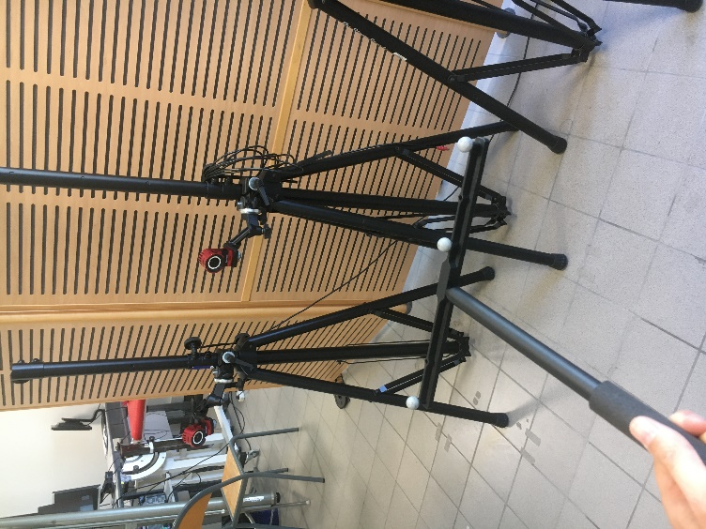
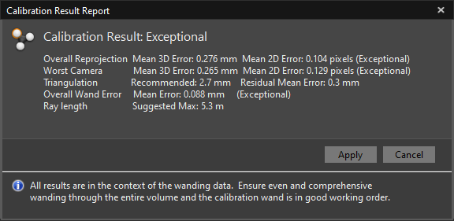
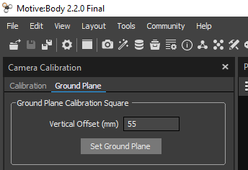
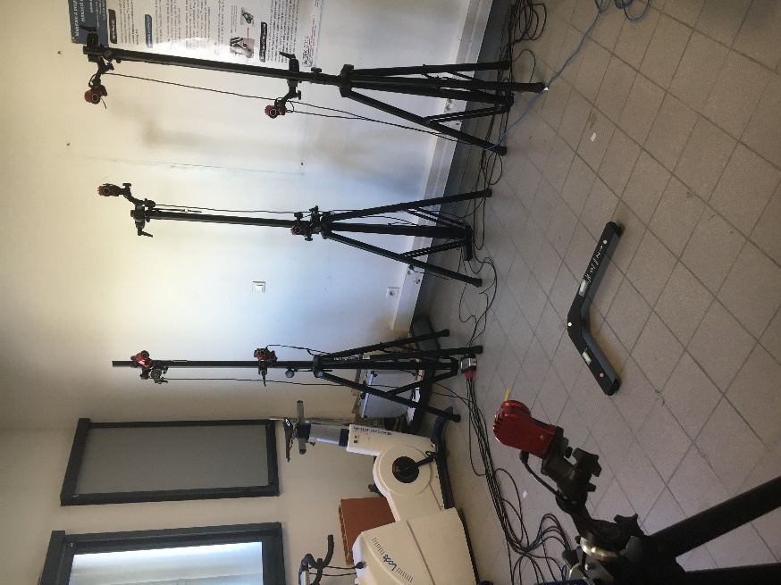
Click on ‘start wanding’ to perform the dynamic calibration of the cameras. Once the number of points is reached, click on ‘calculate’, and then ‘apply’ if the calibration is acceptable. Save the calibration into the session folder.
The tab ‘ground plane’ opens automatically, click on ‘set ground plane’ after putting the reference wand on the ground (not the calibration wand).
Be aware that the orientation of the reference wand will impact your axis for volume reconstruction. It is therefore recommanded that you align one of the axis of the reference wand with your scanning plane during 3D ultrasound.
Then, put away the 2 wands.

Slide 11
CASE n°1 : CALIBRATION OF THE ULTRASOUND PROBE TRACKER → If the probe tracker has been moved → If some settings of the ultrasound (like depth) have been modified
CAS n°2 : DIRECT ACQUISITION WITHOUT RECALIBRATION OF THE ULTRASOUND PROBE TRACKER

Slide 12
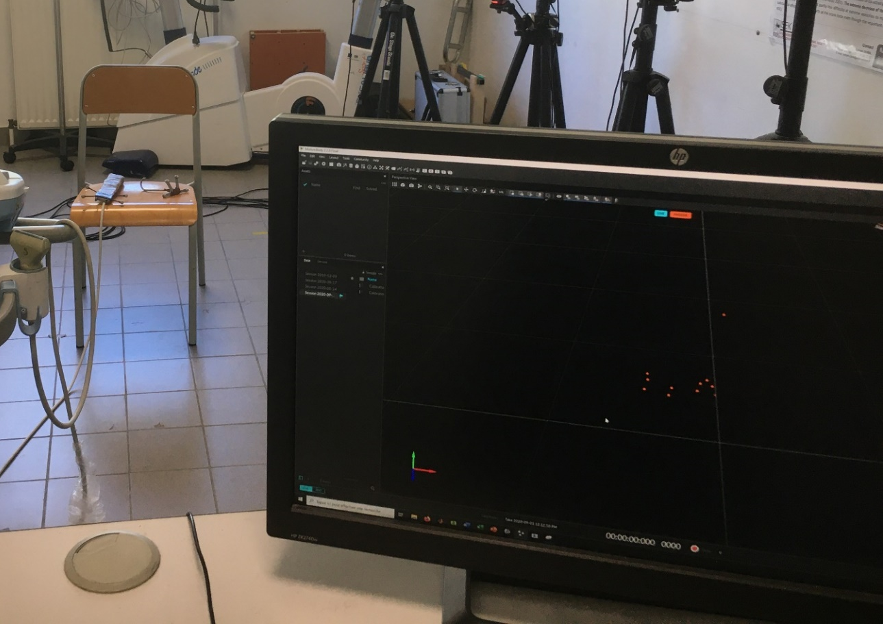
Click on ‘layout’ → ‘capture’
Place the ultrasound probe and the stylus in the volume capture.
If a rigid body already appears in the ‘asset’ tab, remove it.
Click on ‘layout’ → ‘capture’
Place the ultrasound probe in the volume capture.
If a rigid body already appears in the ‘asset’ tab, remove it.

Slide 13
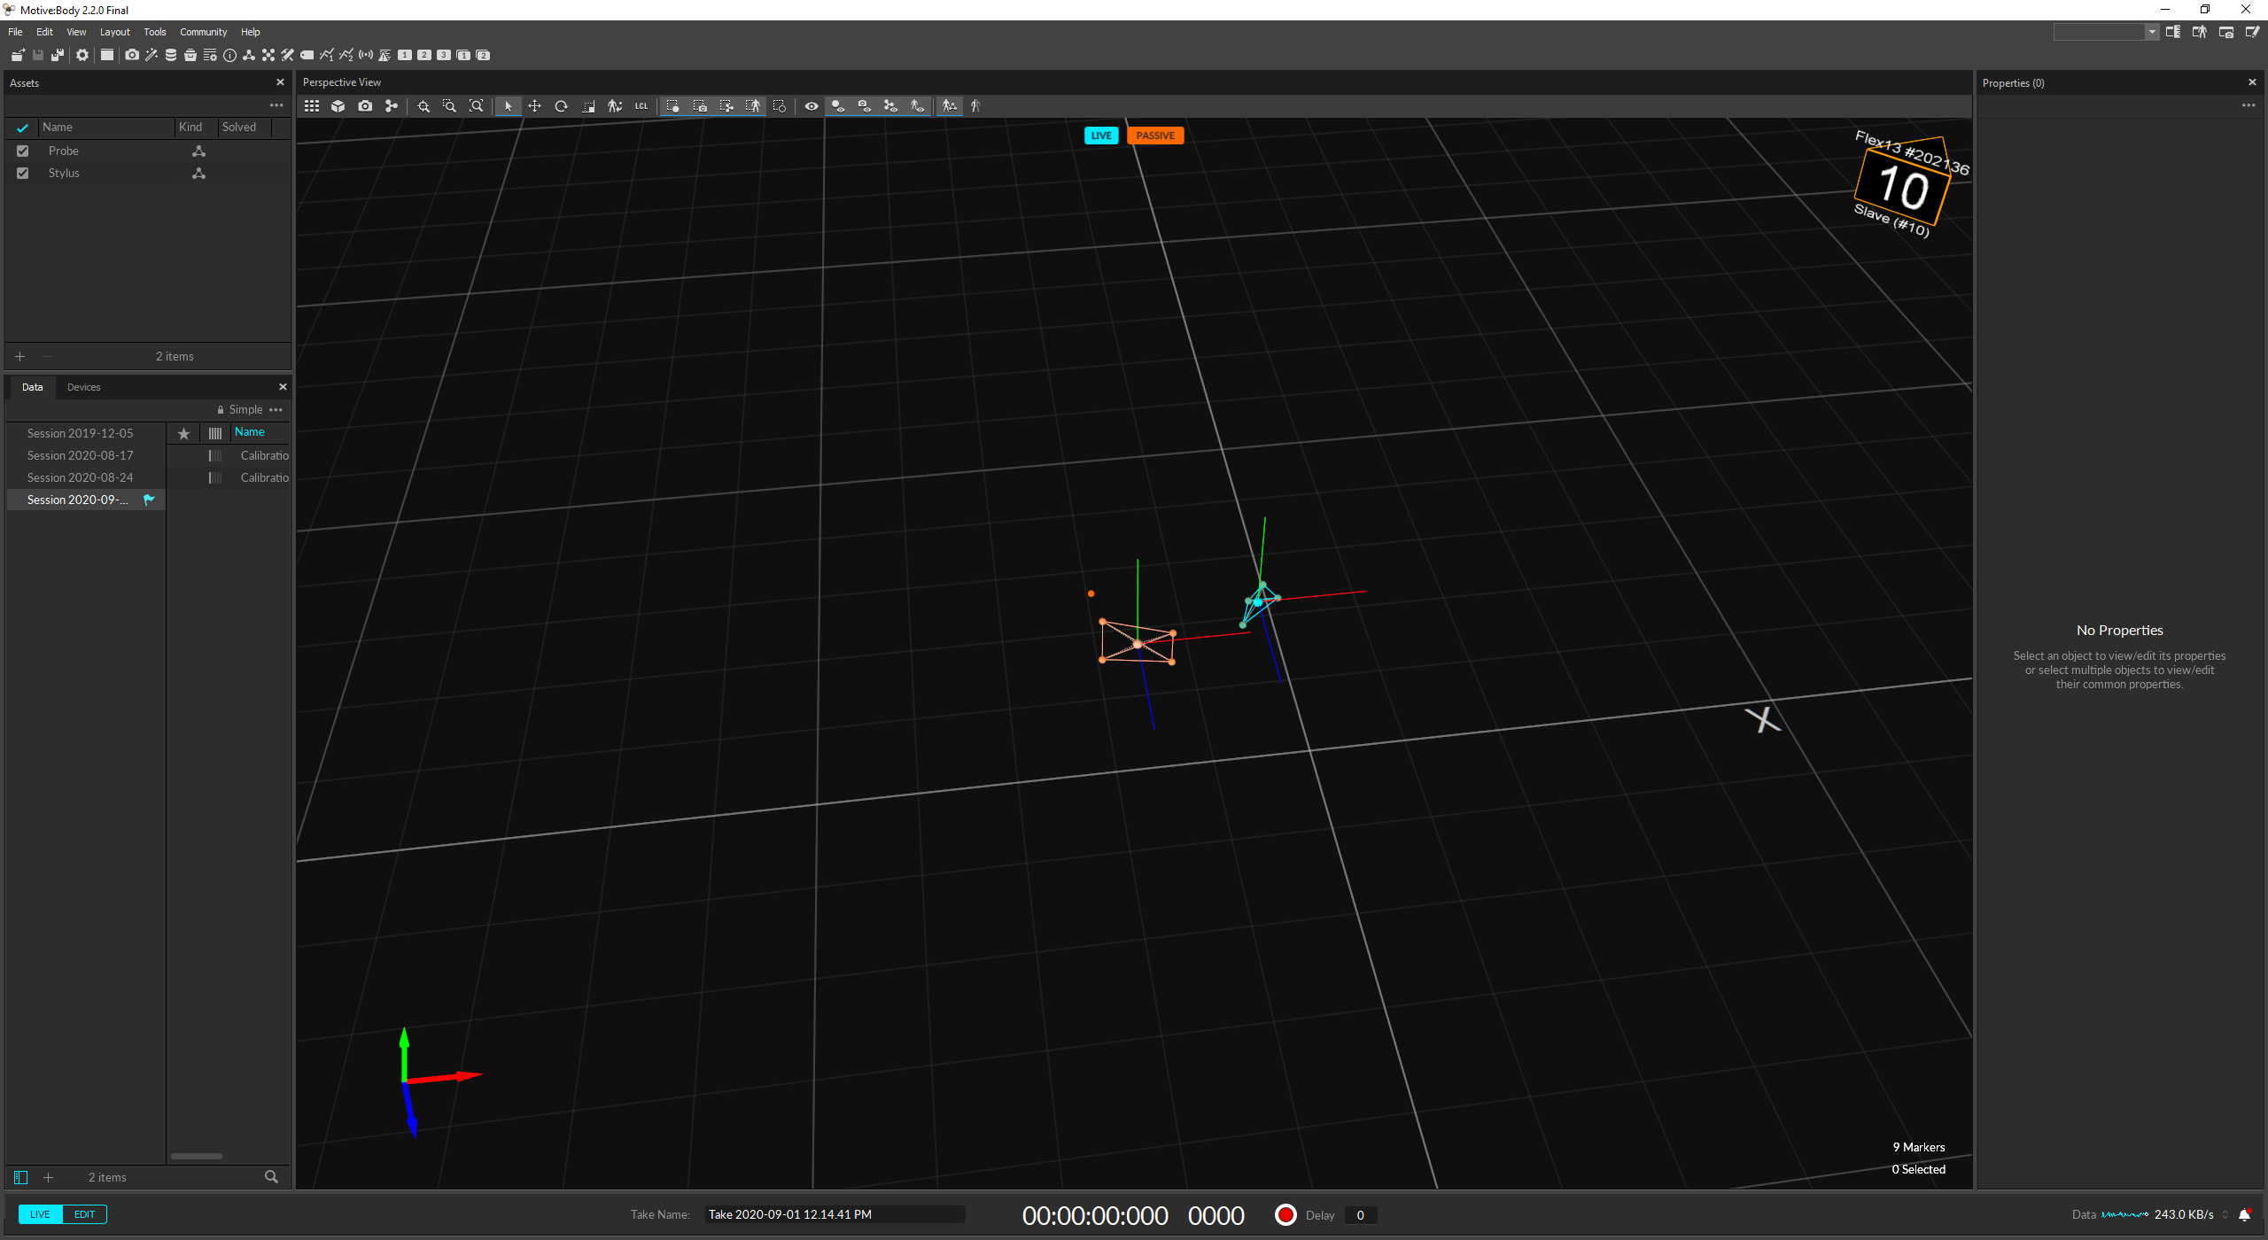

Load into Motive both rigid body ‘Probe.motive’ and ‘Stylus.motive’ located in the folder ‘C:/Users/Labo MIP/PlusApp-2.8.0.20191105-Win64/config’ (select them in Explorer and move them in the ‘Assets’ window)
The probe and the stylus are normally automatically recognised as the rigidbody (move them and visualise the result in the 3D window of Motive).
Load into Motive the rigid body ‘Probe.motive’ located in the folder ‘C:/Users/Labo MIP/PlusApp-2.8.0.20191105-Win64/config’ (select it in Explorer and move it in the ‘Assets’ window)
The probe is normally automatically recognised as the rigidbody (move it and visualise the result in the 3D window of Motive).

Slide 14
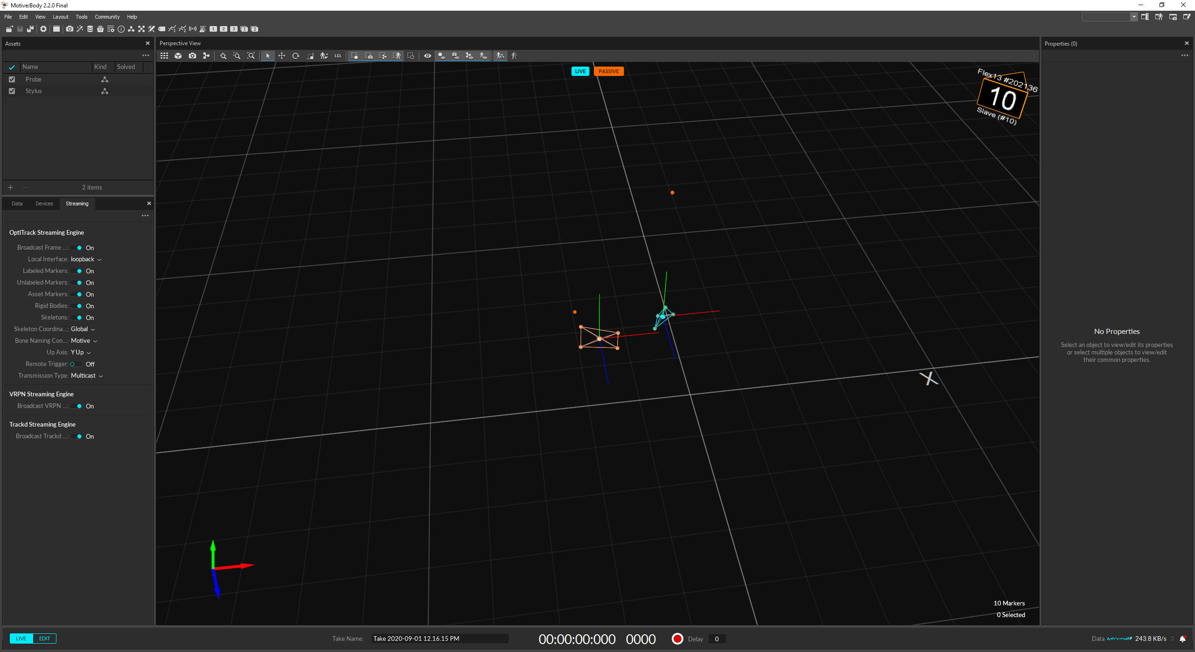
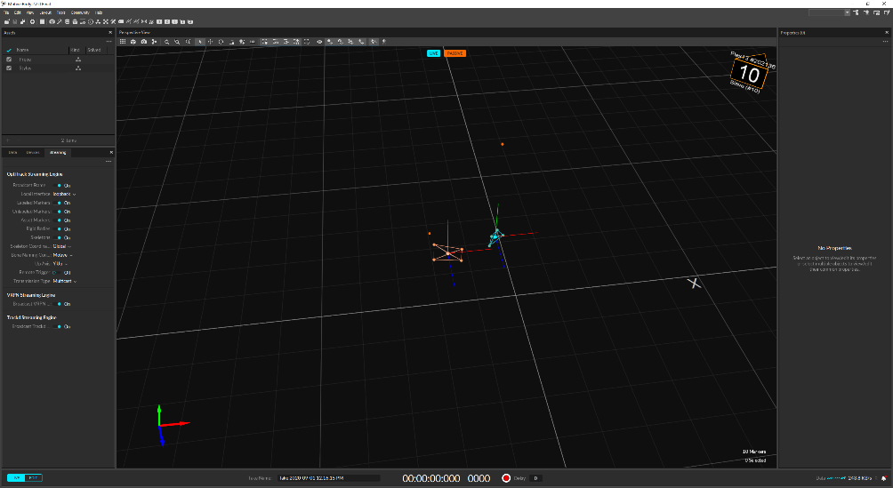
Click on ‘file’ → ‘export profile file as’ and save the file in ‘C:/Users/Labo MIP/PlusApp-2.8.0.20191105-Win64/config’ by renaming it ‘motiveprofilefile’.
Click on « View » → « Data Streaming Pane », then verify that « Broadcast Frame Data » is set to ‘ON’.
DO NOT QUIT MOTIVE.

Slide 15
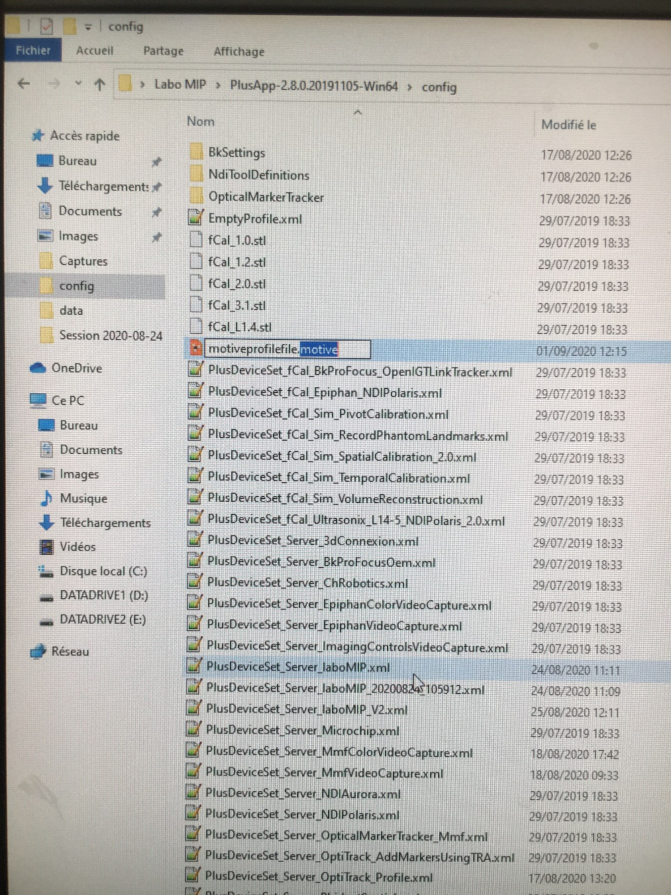
Windows explorer
Rename the newly created file « motiveprofilefile.motive » as « motiveprofilefile.xml »

Slide 16
2. ULTRASOUND VIDEO

Slide 17
SuperShearing Imaging ultrasound
Start the ultrasound
Old versions of SuperSonic ultrasound : For our setup, we use a video splitter in order to have the video signal both on the computer, through the video acquisition box (HDMI → USB), and on the screen of the ultrasound.
For ultrasound MACH30 from SuperSonic, you only have to plug the DisplayPort – HDMI adapter at the rear video output of the ultrasound directly into your video acquisition box.

Slide 18
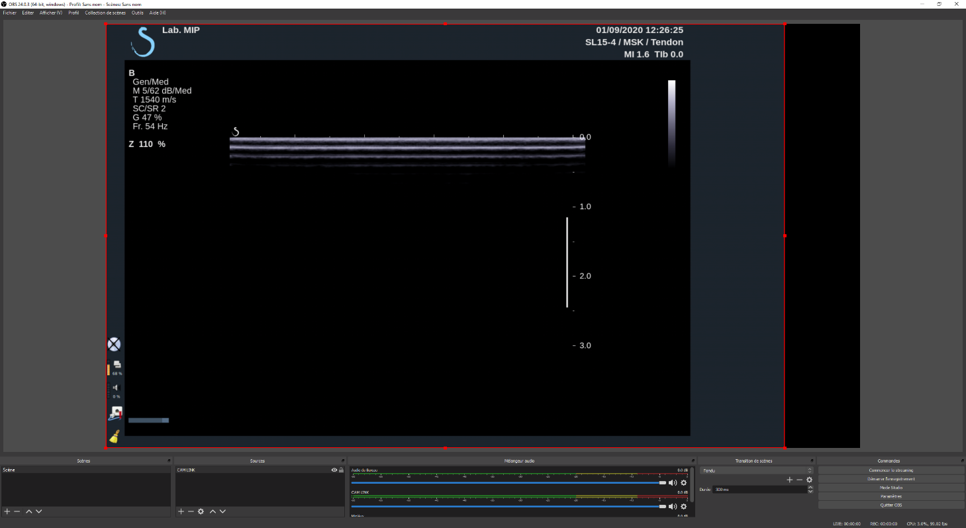
OBS software
Start OBS
Verify that the video signal is OK (all is already set up in the config file)
Set the parameters of the ultrasound and of the probe and verify that the ultrasound image is well included in the limits in red (text from the ultrasound must not be in the limits).
QUIT OBS

Slide 19
3. TEMPORAL CALIBRATION

Slide 20
What is its use ?
To calculate the temporal offset between the tracking from Optitrack and the video stream from the ultrasound.
When to do it ?
If different motion capture system
If different video stream device
If different ultrasound
I don’t need to perform the temporal calibration ?
Go to Slide 24

Slide 21
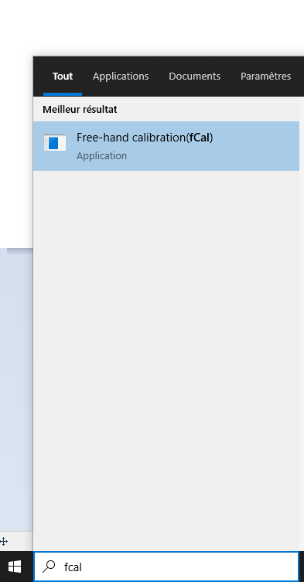
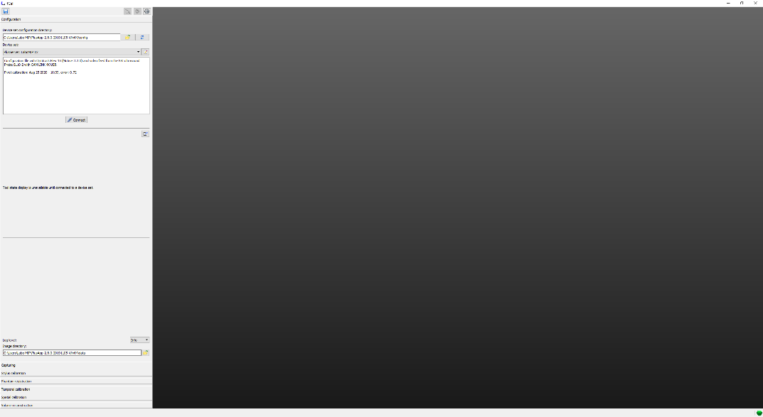
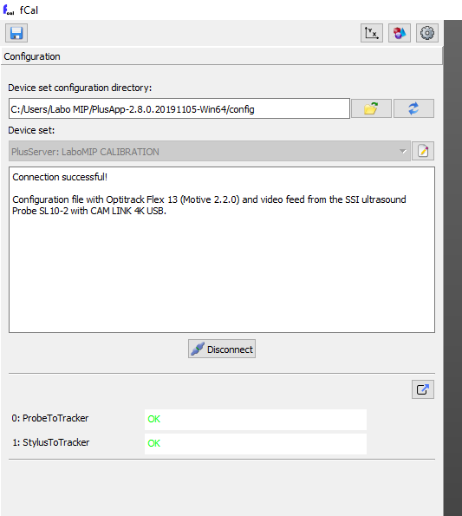
FCAL Software
Start FCAL
Select the config file
‘PlusServer : LaboMIP CALIBRATION’.
Click on ‘connect’
Both signals must be ‘OK’ : ProbeToTracker, StylusToTracker.

Slide 22
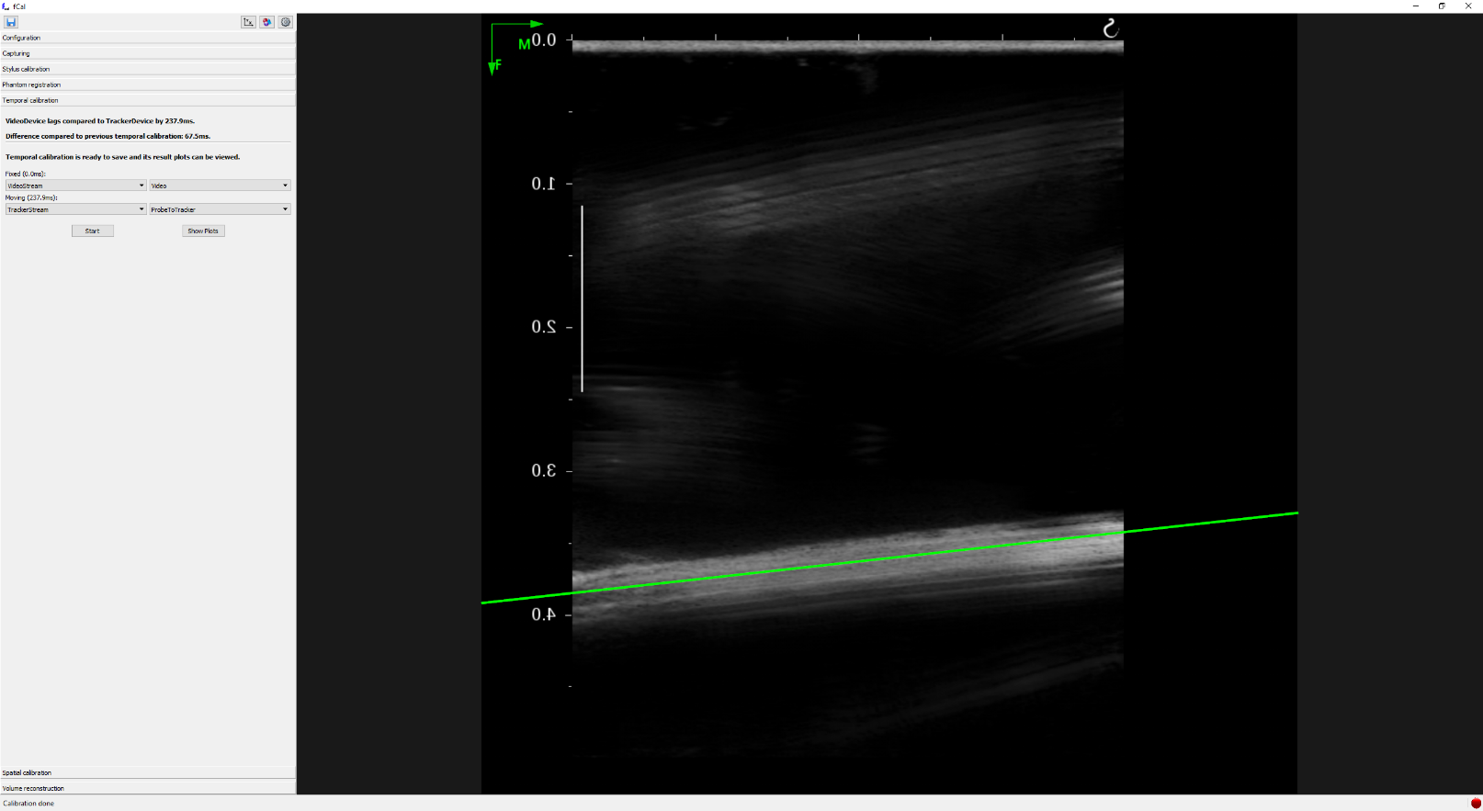
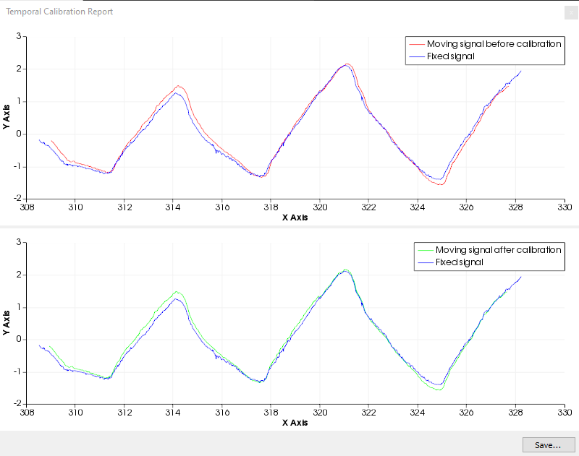
Go to the tab ‘temporal calibration’
Bring the basin of water in the center of the camera volume. Wait for the water to stabilize in the basin.
Click on ‘start’.
Rapidly and before the calibration starts, do a periodic movement from top to bottom with the ultrasound probe kept vertical in the water.
Click on ‘show plots’ to check the quality of the calibration : the initial offset between the signals must be cancelled.
VIDEO

Slide 23
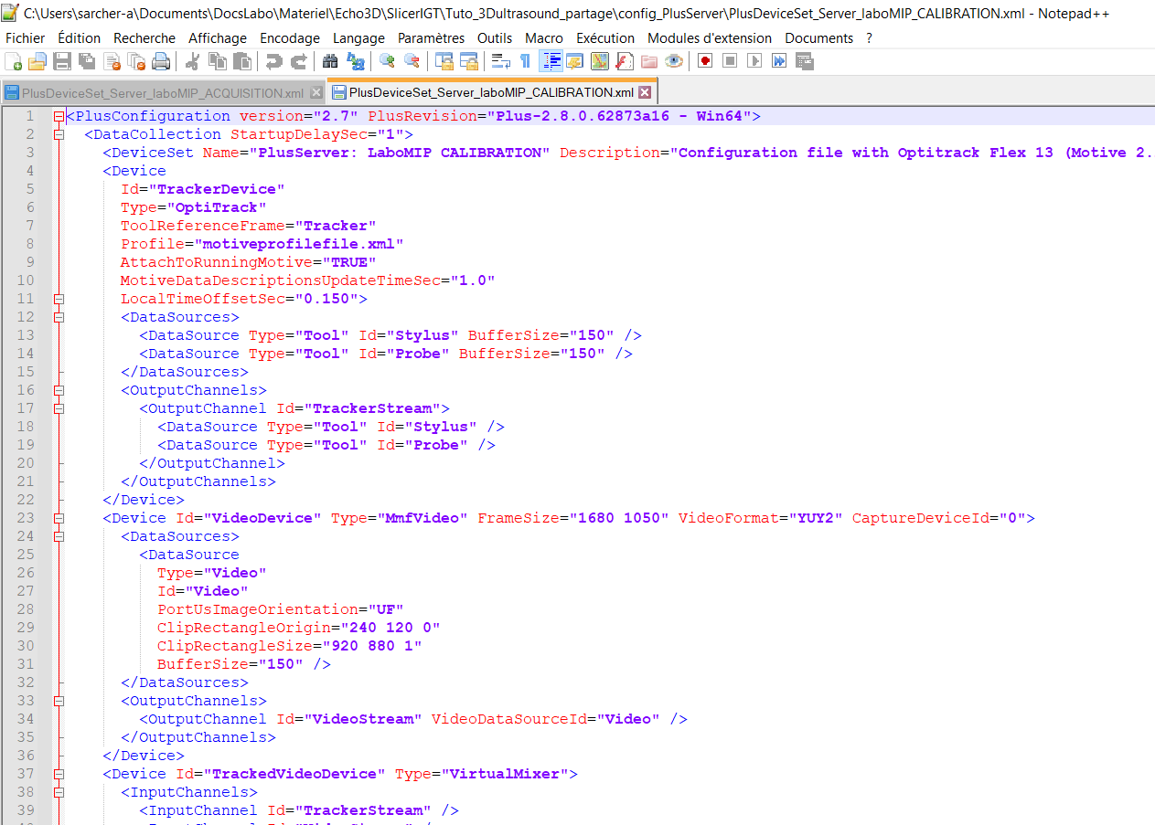
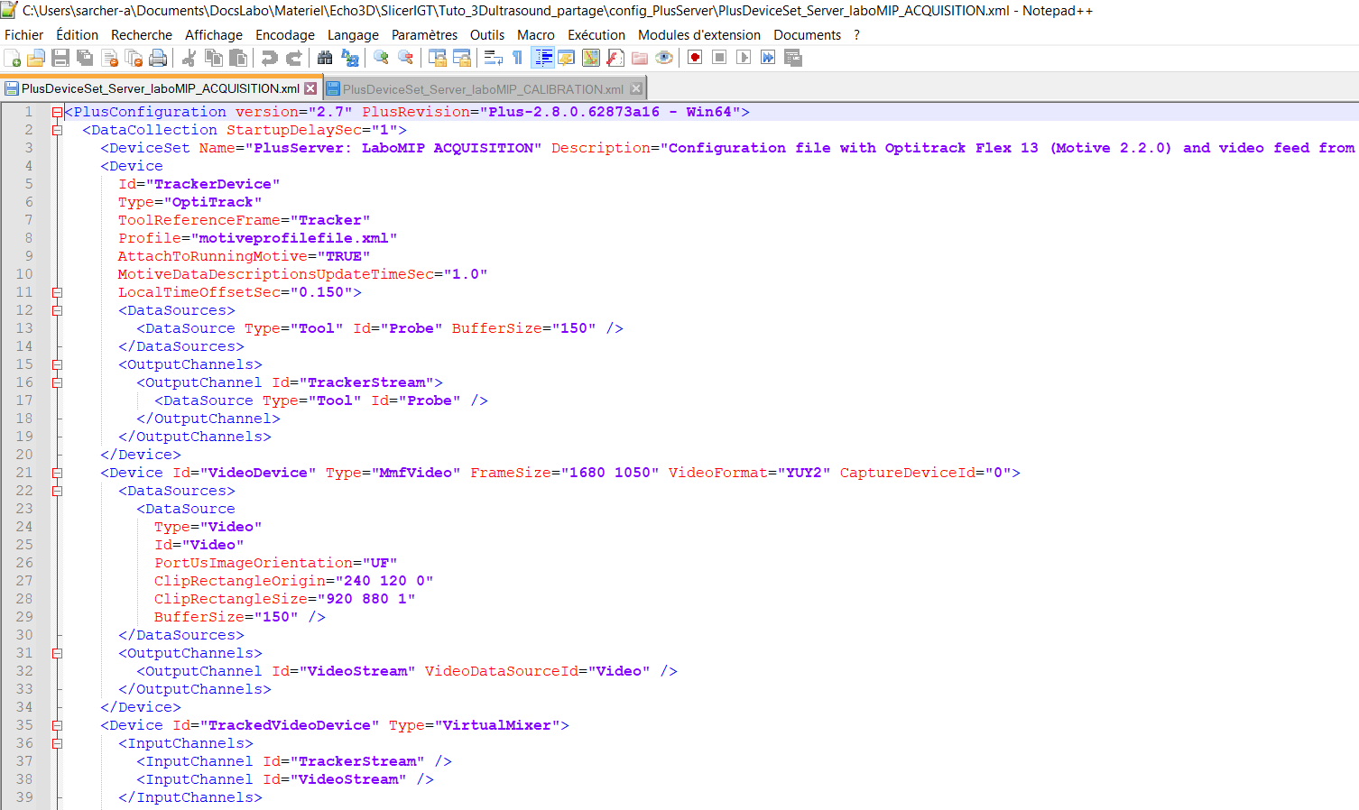
Note the value obtained following temporal calibration, for example : ‘150ms’
In windows explorer, open the files
‘PlusDeviceSet_Server_laboMIP_ACQUISITION’ and ‘PlusDeviceSet_Server_laboMIP_CALIBRATION’ using Notepad++.
Copy the value ‘0.150’ after ‘LocalTimeOffsetSec’
Save both files, and QUIT NOTEPAD.
QUIT FCAL

Slide 24
4. PROBE CALIBRATION

Slide 25
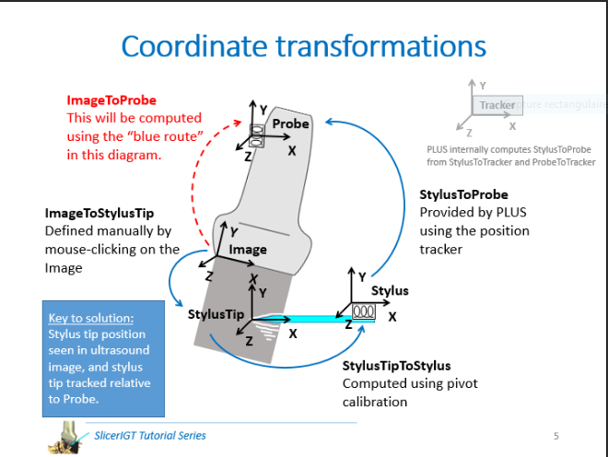
When to do it ?
What is its use ?
To calculate the transform matrix between the referential of the probe (the markers) and the ultrasound image.
See explanations →
If the markers holder moved according to the probe
If the settings of the probe (especially depth) have been changed
BE CAREFUL TO CORRECTLY SETUP THE SETTINGS OF THE PROBE AND THE ULTRASOUND, IT WILL NOT BE POSSIBLE AFTERWARDS

Slide 26
I don’t need to calibrate the probe ?
Go to Slide 39

Slide 27
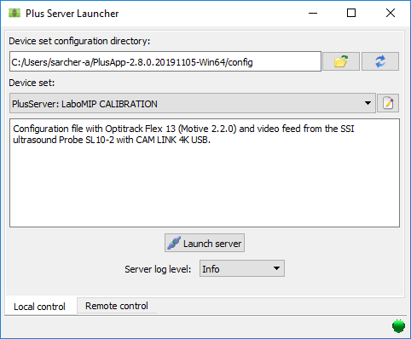
Plus Server Launcher software
Start Plus Server Launcher
Load the file LaboMIP CALIBRATION
Click on ‘Launch Server’
DO NOT QUIT ‘Plus server’

Slide 28
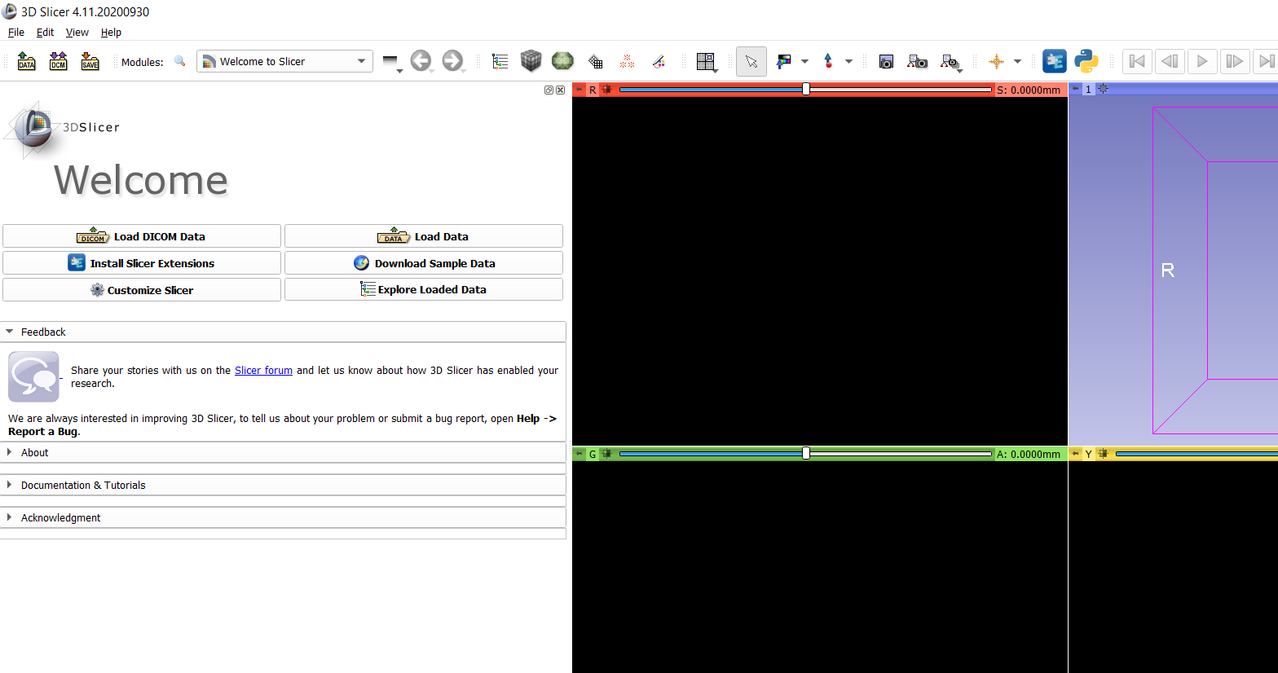

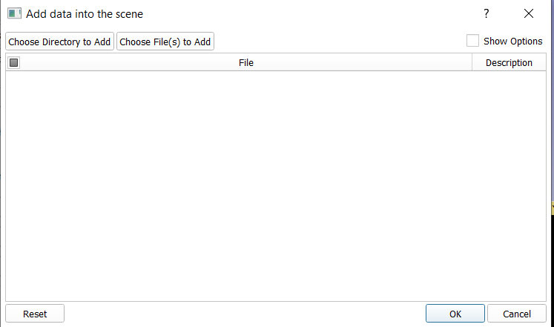
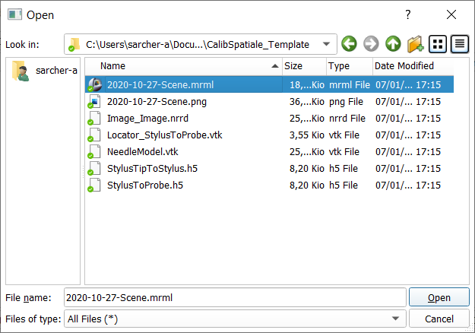
3D SLICER
Launch 3D Slicer
Click on
Click on ‘Choose File(s) to Add’
Load the scene file (file .mrml) in the folder ‘C:/Users/Labo MIP/PlusApp-2.8.0.20191105-Win64/config’ → ‘CalibSpatiale_Template’.
This folder has been pre-configured with the StylusTipToStylus transform of the stylus used in the MIP laboratory.

Slide 29
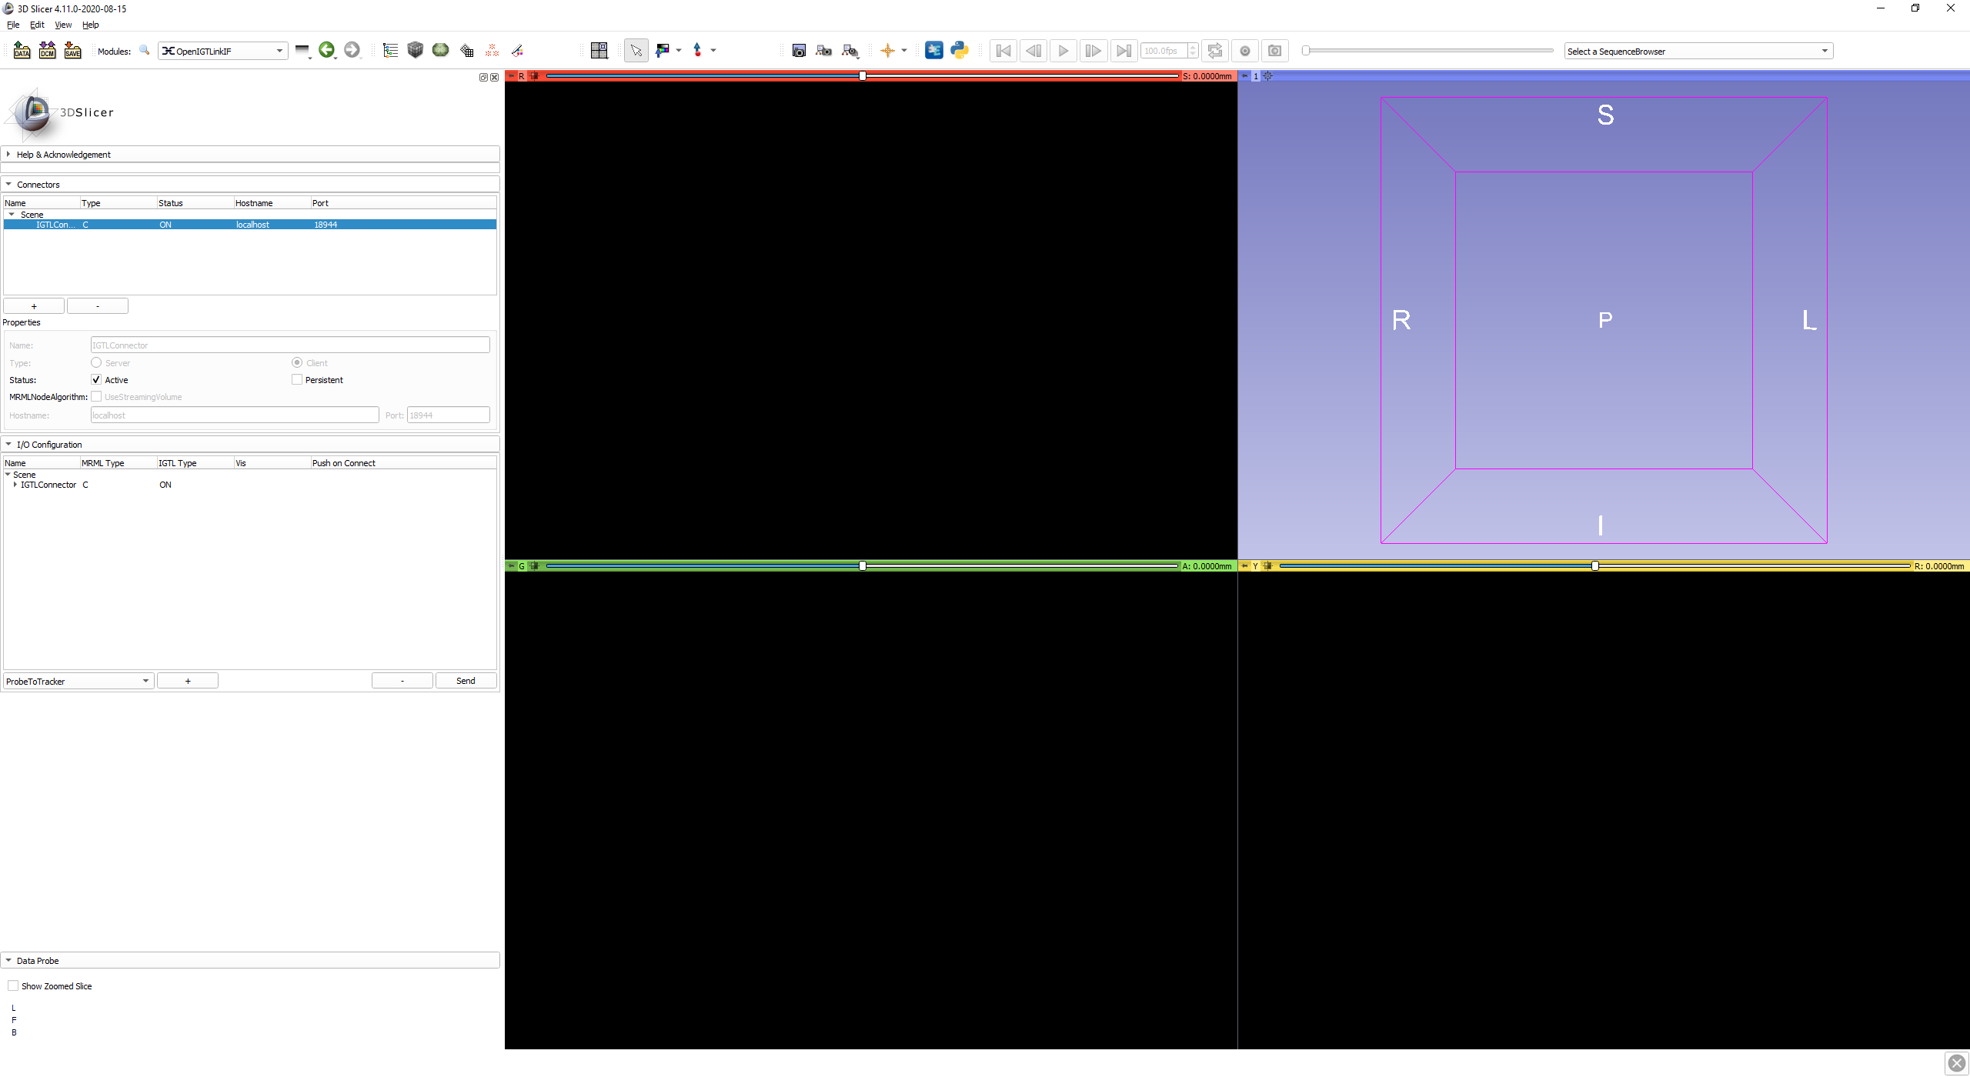
3D SLICER
Choose the module « IGT » → « OpenIGTLinkIF »
Verify that « Hostname » = « localhost », port = 18944
Select IGTLConnector and check « status » = « active ».
The status indicator must be on « ON », Slicer is correctly connected to PLUS.
Click on the arrow on the left of IGTLConnector, then on the arrow on the left of IN, to verify that both eyes are open :

Slide 30
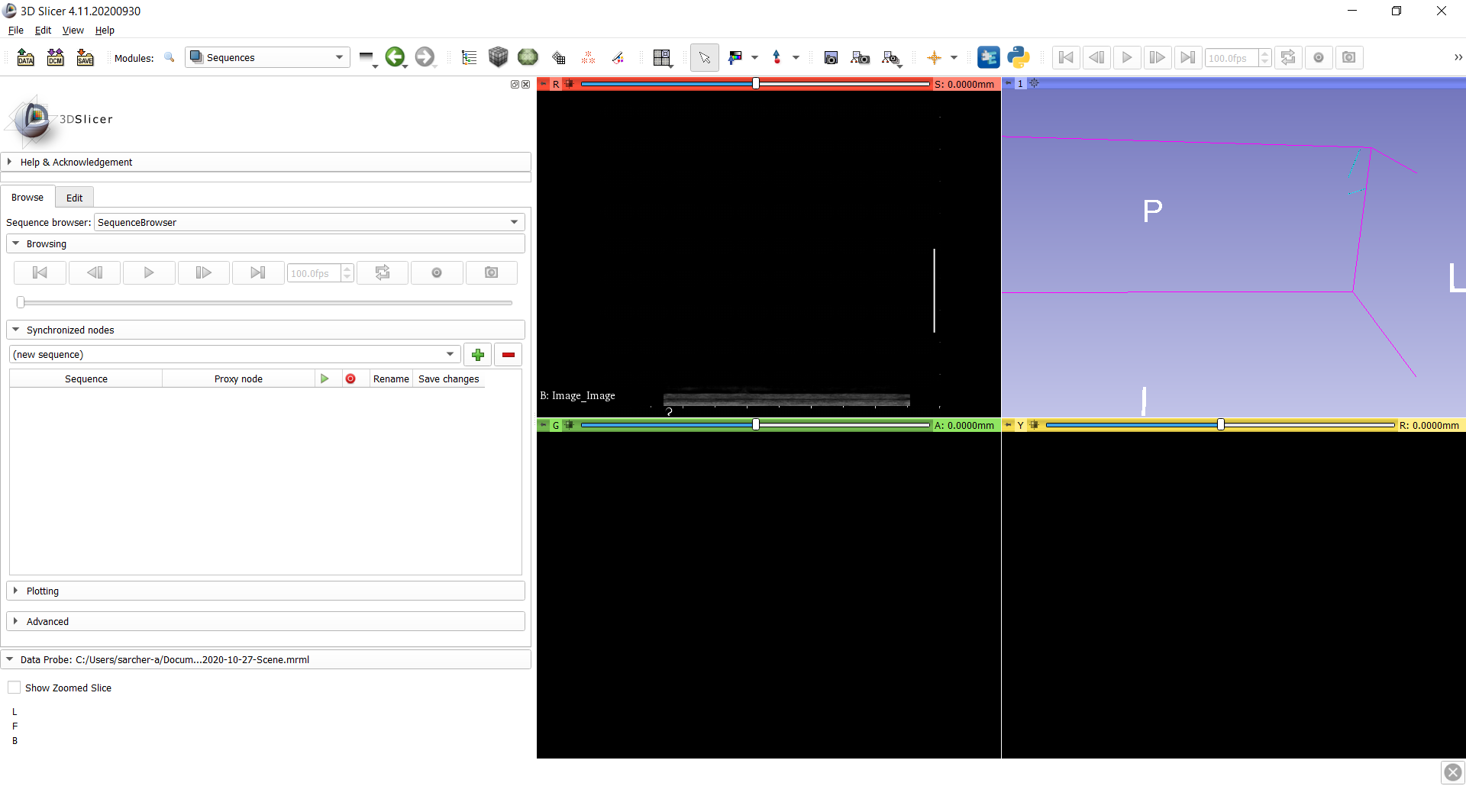
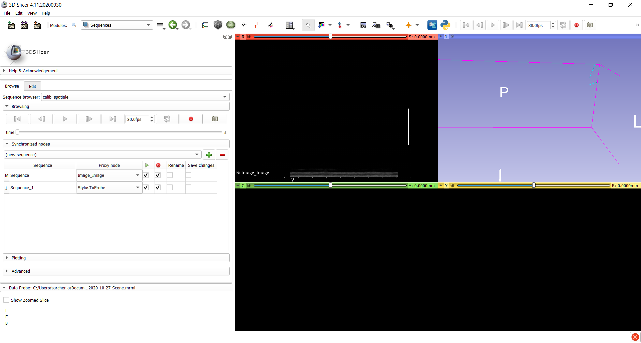
3D SLICER
Choose the module « Sequences »
Click on the drop-down menu ‘SequenceBrowser’
Choose ‘calib_spatiale’

Slide 31
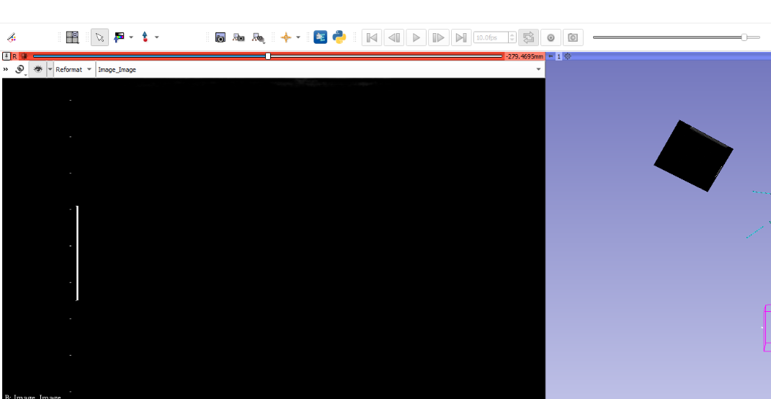
To adjust the 2D ultrasound image to the screen, click on the square with the grey nuances

Slide 32
Record the spatial calibration sequence by clicking on the red circle.
The calibration sequence consists in making the stylus tip appear clearly on the ultrasound image, at least four times (in each corner of the ultrasound image).
Then, rotate both stylus and probe at least 45° and redo the same (again at least 4 appearances of the stylus tip on the ultrasound image).
VIDEO

Slide 33
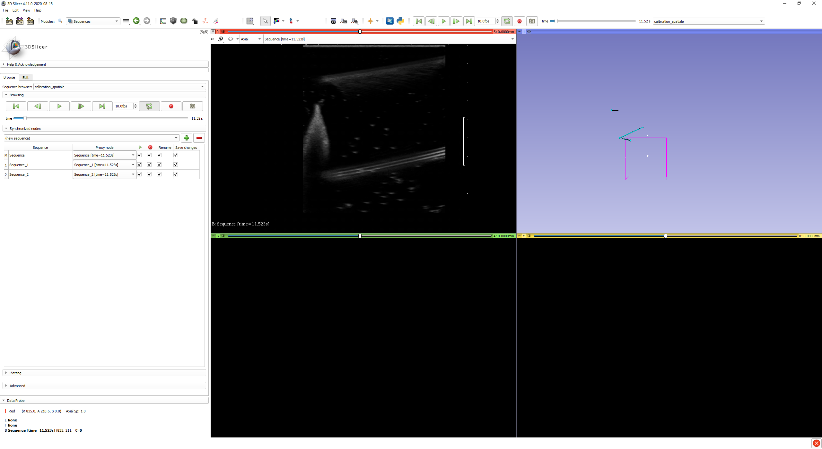
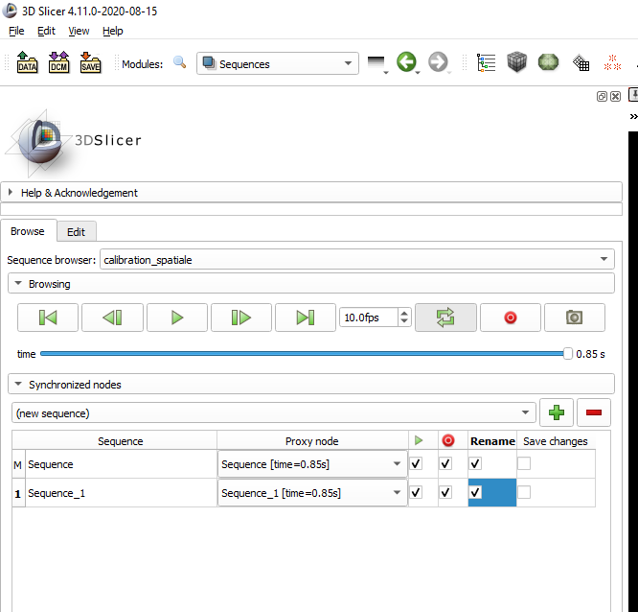
After acquisition, check the column ‘rename’ for both nodes.

Slide 34
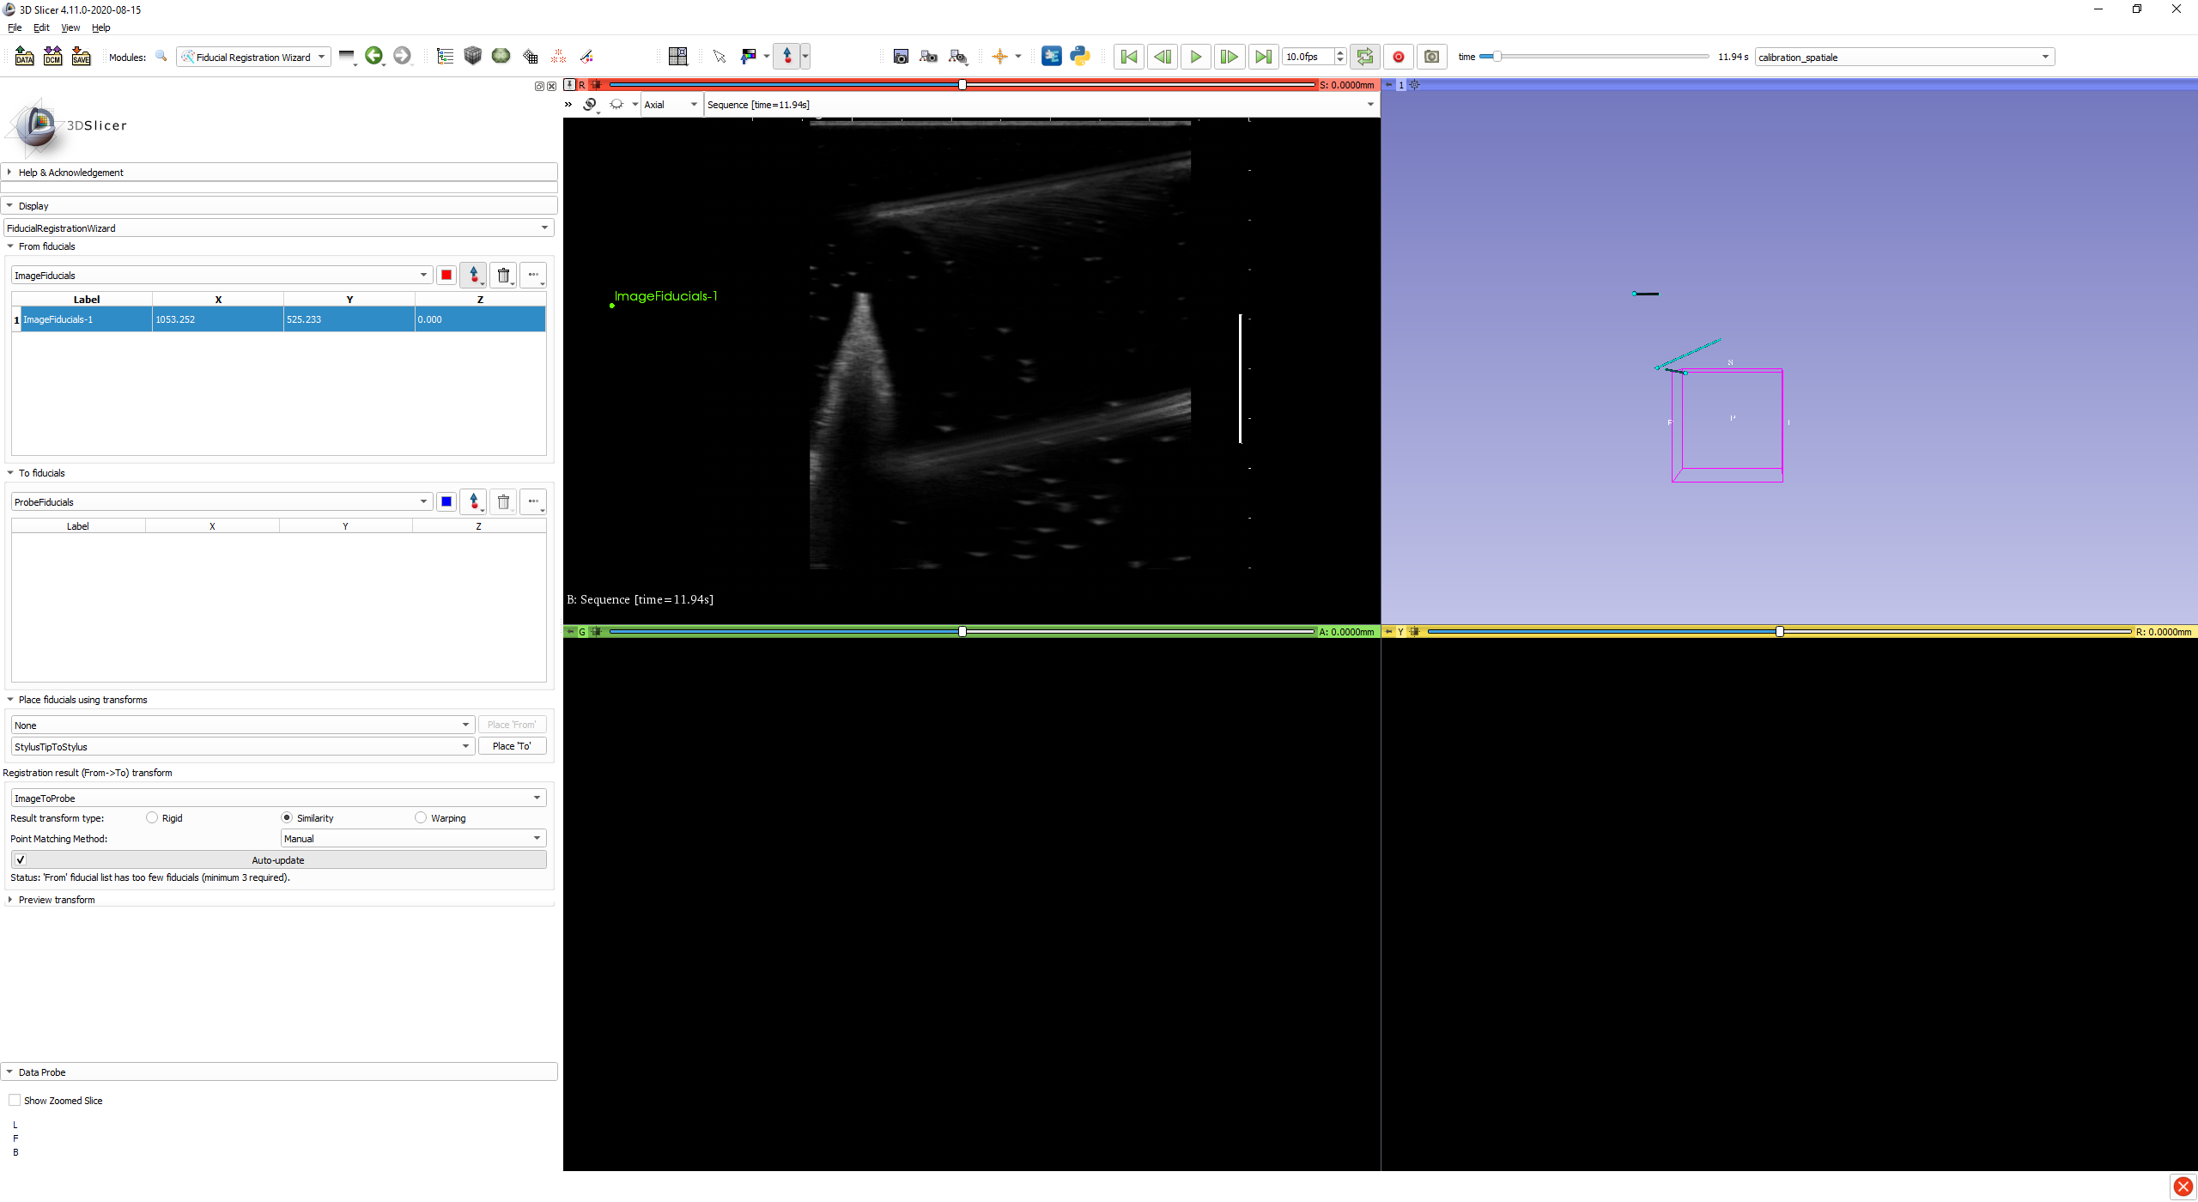
Open the module ‘Fiducial Registration Wizard’
‘from fiducials’ → ‘create new markupsFiducial as…’ and rename ‘ImageFiducials’
‘to fiducials’ → ‘create new markupsFiducial as…’ and rename ‘ProbeFiducials’
‘place fiducials using transforms’ → first ‘none’ second ‘StylusTipToStylus’.
‘registration results’ → ‘create new transform as…’ and rename ‘ImageToProbe’
Select ‘similarity’ and ‘manual update’.

Slide 35
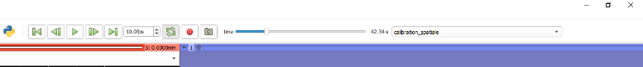
Play the spatial calibration sequence.
Press pause when the stylus tip appears on the ultrasound image.
On the icon with the arrow upward corresponding to ‘ImageFiducials’
Click on the ultrasound image on the stylus tip.

Slide 36
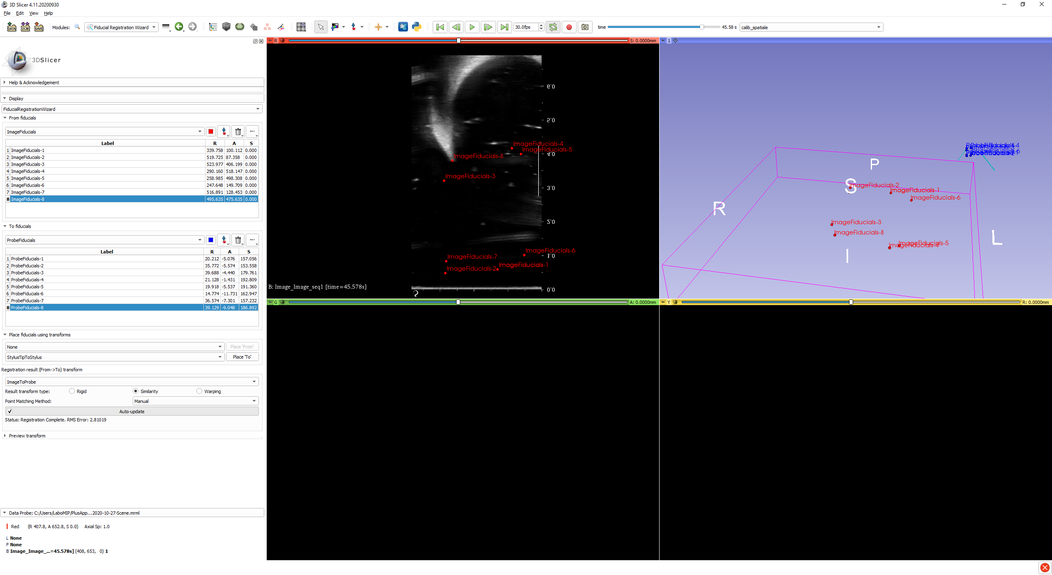
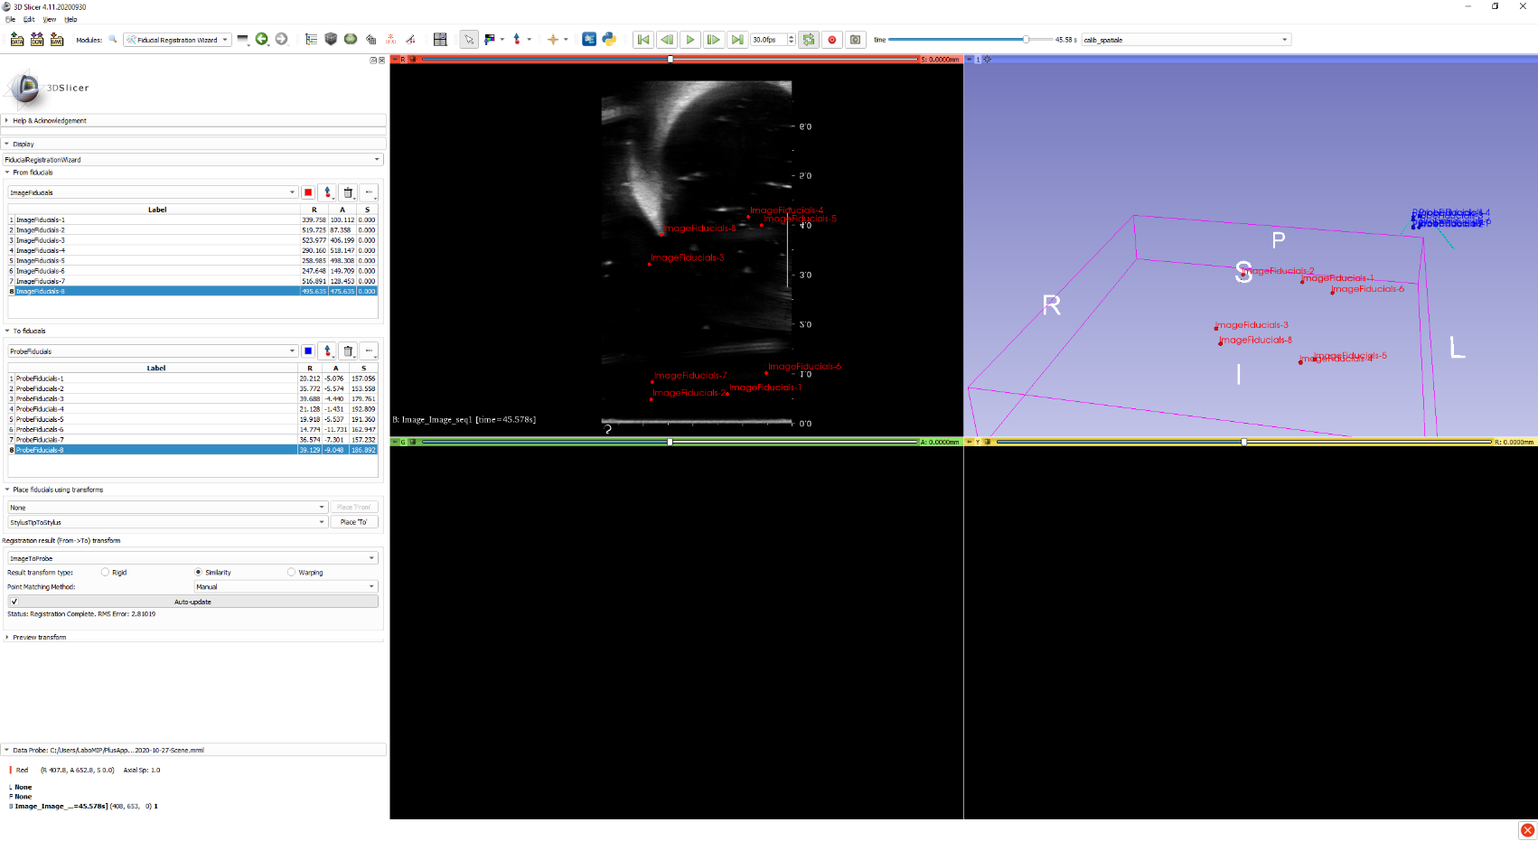
Click on ‘place to’ for every fiducial added, so that the software can match the fiducial on the ultrasound image ‘image’ to a fiducial of the probe tracker ‘probe’.
The transform ImageToProbe is automatically calculated (the RMS error is displayed).
The RMS error must be between 1 and 3.

Slide 37
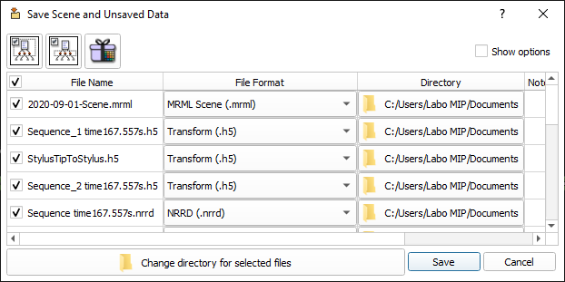
Click on ‘File’ → ‘Save’
Check all elements of the scene
Choose the folder to save all the elements ‘Change directory for selected files’, for example ‘calibration_15092020’.
Click on ‘Save’
Wait, this step can take one or two minutes.
QUIT SLICER 3D AND PLUSSERVER

Slide 38
In Windows explorer, go to the folder in which the spatial calibration was just saved, and copy the file ‘ImageToProbe.h5’
Paste this file in the folder ‘C:/Users/Labo MIP/PlusApp-2.8.0.20191105-Win64/config’ → ‘Scene_Template_Probe10-2_Prof4,5’, by modifying if needed the name of the folder to conform to the actual characteristics (probe model, depth, etc.)

Slide 39
5. ACQUISITION

Slide 40
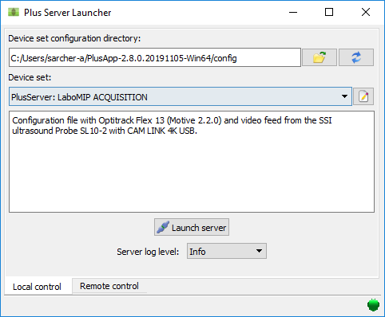
Plus Server Launcher Software
Start Plus Server Launcher
Load the file LaboMIP ACQUISITION
Click on ‘Launch Server’
DO NOT QUIT ‘Plus server’

Slide 41
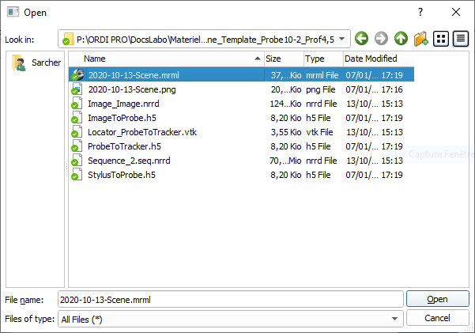
3D SLICER
Launch 3D Slicer
Click on
Click on ‘Choose File(s) to Add’
Load the file scene (fichier .mrml) in the folder ‘C:/Users/Labo MIP/PlusApp-2.8.0.20191105-Win64/config’ → ‘Scene_Template_Probe10-2_Prof4,5’ (or any other name depending on the probe and depth parameters)

Slide 42
3D SLICER
Choose the module « IGT » → « OpenIGTLinkIF »
Verify that « Hostname » = « localhost », port = 18944
Select IGTLConnector and check « status » = « active ».
The STATUS indicator must be on ‘ON’, indicating that Slicer is correctly connected to PLUS.
Click on the arrow on the left of IGTLConnector, then on the arrow on the left of IN, to verify that both eyes are open :

Slide 43
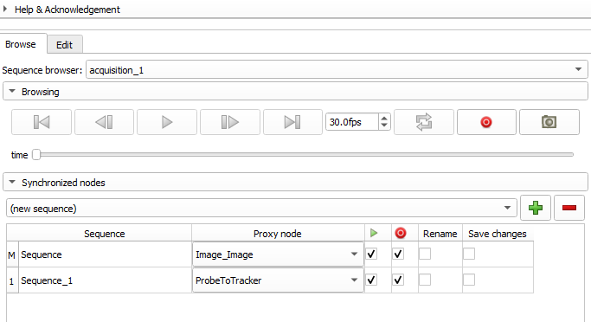
3D SLICER
Choose the module « Sequences »
Click on the drop down menu ‘SequenceBrowser’
Choose ‘acquisition_1’

Slide 44
Do not check the columns ‘rename’ and ‘save changes’.
Record the acquisition by clicking on the red dot.
After the recording is finished, check the column ‘rename’ for both nodes.

Slide 45
6. VOLUME RECONSTRUCTION

Slide 46
CASE 1 : I just performed an acquisition
Go to the next slide.
CASE 2 : I wish to process saved data
Start Slicer 3D
Click on ‘File’ → ‘Add data’ → ‘Choose File(s) to Add’
Select in the folder with the saved data the file ‘Scene’ with the format ‘.mrml’
The loading time can be a bit long.

Slide 47
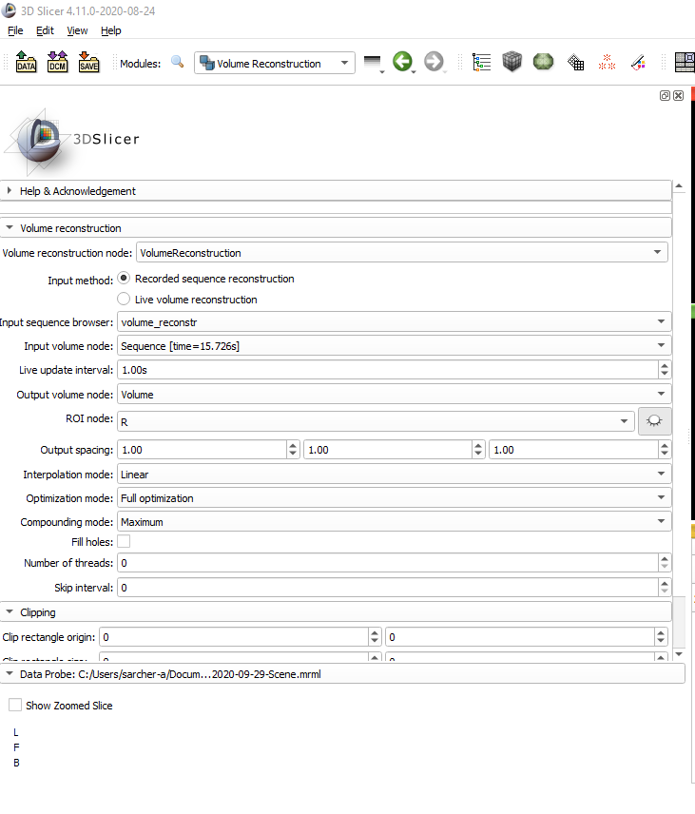
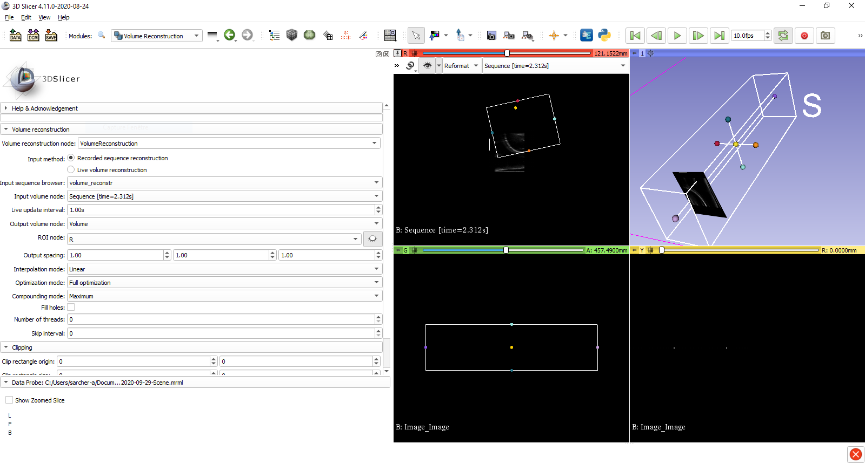
Go to the module ‘volume reconstruction’,
input method : ‘recorded sequence reconstruction’
Input sequence browser : choose the recorded sequence ;
input volume node : ‘Sequence [XXs]’,
output volume node : ‘create new volume as…’.
ROI node : ‘create new AnnotationROI’
In the 3D view, adjust manually the dimensions of the ROI to contour the volume scanned during the recording. If needed, display the ROI by clicking on the eye and by playing the recorded sequence (green bar at the top right of the screen)
Note : the bigger the ROI and the longer the reconstruction will take

Slide 48
Output spacing : this is the settings of reconstruction regarding the voxel size, which the unit of the 3D volume. This voxel has 3 dimensions :
In the ultrasound image plane, you have to measure the equivalent in pixels of 1 cm (there is the ultrasound image scale, you can have the equivalent in pixels using 3D Slicer). The unit to put in the software is in mm/pixels, so if you measure 100pixels for 1 cm, then the value is 10mm/100pixels=0,1
In the transverse axis (the one along which you swept the probe), you need to put the average distance in mm travelled between 2 frames, which depends on the scan speed and the acquisition frequency. Advice : Put 1 in the first place, and diminush it if needed and if you think you can be more precise.
To find the axis corresponding to these different elements, you have to look in the ROI which axis is the one corresponding to the transverse axis of sweeping of the probe. The two other parameters will be the values calculated for the plan of the ultrasound image.
Light blue / dark blue axis → Put the value of the transverse axis in the 3rd case (axis Z/K)
Purple /purple axis → Put the value of the transverse axis in the 1st case (axis X/I)
Red / orange axis → Put the value of the transverse axis in the 2nd case (axis Y/J)
Interpolation mode : linear
Optimization mode: full optimization
Compounding mode : mean
check fill holes
Case 1 / Case 2 / Case 3
In this case, the transverse axis is the purple/purple axis, you need to put the parameters :
1.00 / 0.10 / 0.10
(example values)

Slide 49
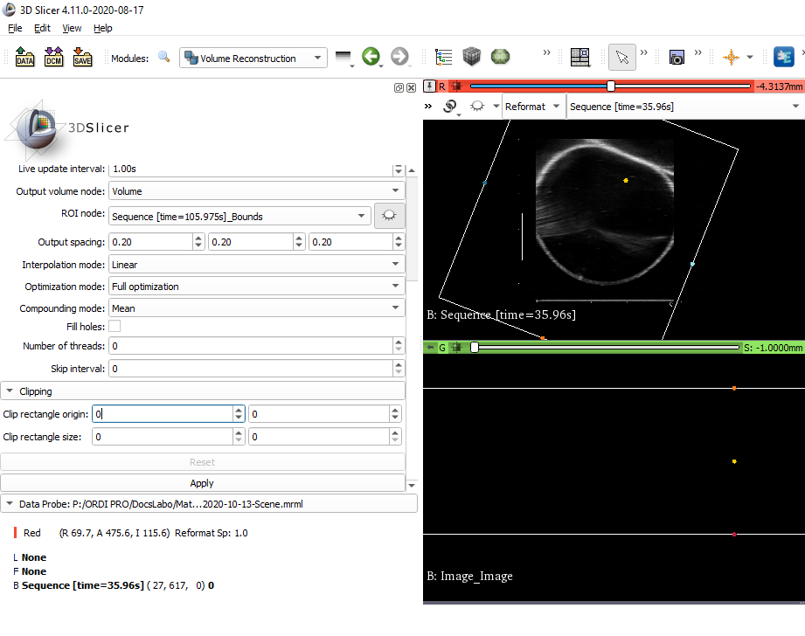
The ultrasound image included in the red window (rectangle 1) includes some writing, some marks, some black strips, etc. For the volume reconstruction, these elements must not be included, or else the volume won’t be correctly reconstructed. The image must be clipped to select only the real ultrasound image (rectangle 2).
You can find the coordinates of your mouse by travelling on the ultrasound image in the bottom left part of the screen.
Note the coordinates of the Point A which delimite the bottom left corner of the rectangle 2, and note these values in Clipping → Clip rectangle origin.
Note the coordinates of the Point B which delimite the top right corner of the rectangle 2, and note the values [Point B – Point A] in Clipping → Clip rectangle size.
Click on ‘apply’.
Note : At the end of the reconstruction, it is normal that the volume does not display automatically.
1
2
Point A
Point B

Slide 50
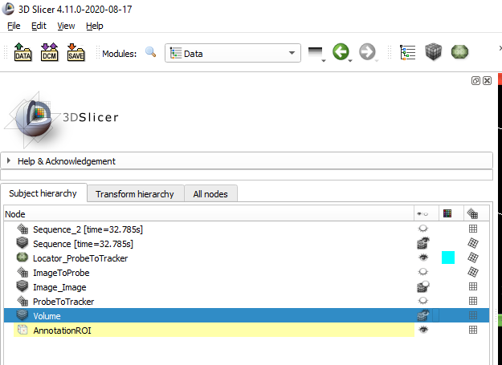

Go back to the module ‘data’, go to the tab ‘Subject hierarchy’.
Display the volume :
Left click on the eye displays the volume in the 2D views.
Change the view ‘reformat’ to ‘Sagittal’ or ‘axial’ or ‘coronal’ in the red view.
The volume can also be visualized in the yellow and green views.

Slide 51


For a 3D visualization of the volume, right click on the eye and select ‘show in 3D views as volume rendering’
If the volume appears solid black in the 3D view, right click on the eye and then ‘volume rendering options’ or go to the module ‘volume rendering’ to change the volume visualization settings.
The preset ‘MR-Default’ is usually working fine.
The shift value can be modified to improve the rendering.

Slide 52

DATA SAVING
Click on « save »
Select all elements
Chose the folder to save all elements ‘Change directory for selected files’, for example ‘acquis_1’.
To win some time during the saving, it is possible to uncheck the automatic data compression option. Careful, the data will be in consequence quite heavy.
Click on ‘Save’

Slide 53
7. SEGMENTATION

Slide 54
CAS 1 : My data is already loaded
See you next slide
CAS 2 : I load my data
Open Slicer 3D
Click on ‘File’ → ‘Add data’ → ‘Choose File(s) to Add’
Select in the wanted folder the file ‘Scene’ in the format ‘.mrml’
Recommendation : loading a full scene might take some time and use a lot of resources of the computer. For the segmentation, you can load only the reconstructed volume file, in the format .nrrd.

Slide 55


Open the module ‘Segment Editor’
Segmentation : create a new segmentation
Master volume : choose the reconstructed volume
Click on ‘Add’ to add a segment
Choose the effect ‘Paint’ to draw the outline of the volume. The diameter of the brush can be modified between 1% and 40%. Zooming the 2D view can help being more precise.
Draw with the mouse (click and maintain) the volume outline for this slice.
Careful, the segmentation must be done in one of the plans ‘axial’ ‘sagittal’ or ‘coronal’ but not in the ‘reformat’ plan.

Slide 56

Move inside the volume with the axis located just above the 2D views (displacement in space)
Create all the volume outline needed.
To see the segmentation in the 3D view, click on ‘Show 3D’.

Slide 57


Once all the outlines are drawn, choose the effect « Fill between slices »
Click on ‘initialize’
Click on ‘show 3D’ to get a preview in the 3D view.
Click on ‘apply’
The segmentation is then filled between the slices :

Slide 58



To get informations about the segmentation (for example the volume)
Open the module ‘Segment Statistics’
Segmentation : choose the segmentation
Scalar volume : choose the volume
Output table : Create a new table
Advanced :
Deactivate the ‘labelmap statistics’ and the ‘closed surface statistics’
Click on ‘options’ of ‘scalar volume statistics’ to choose the parameters.
Click on ‘apply’ to get the volume statistics.
The table is displayed under the 4 visualization windows.

Slide 59
8. APPENDICES

Slide 60
CONFIGURATION FILES

Slide 61

Configuration file ACQUISITION
Part which is about the calibration of Optitrack.
Nothing has to be changed except the time calculated during the temporal calibration : LocalTimeOffsetSec=« ».
For the acquisition part, only the position of the probe tracker is streamed by Optitrack. A flux « TrackerStream » is created.
Part which is about the configuration of the ultrasound video. The first line is specific to the video capture device used. « ClipRectangleOrigin » et « ClipRectangleSize » is a first ultrasound video cropping to remove unnecessary parts fo the image. A flux « VideoStream » is created.
A flux « TrackedVideoStream » is created from both flux « TrackerStream » and « VideoStream ».

Slide 62

The flux « TrackedVideoStream » is sent through PlusOpenIGTLinkServer by the port 18944 that you can modify with the option « ListeningPort ». The types of information sent are precised (IMAGE for the video and TRANSFORM for the probe tracker position).
Part which is about the configuration of fCal. In our case, only the temporal calibration is realised using fCal. The parameter « TemporalCalibrationDurationSec » allows to modify the length of the calibration.

Slide 63

Configuration file CALIBRATION
Part which is about the calibration of Optitrack.
Nothing has to be changed except the time calculated during the temporal calibration : LocalTimeOffsetSec=« ».
For the calibration, the probe tracker position « Probe », and the stylus position « Stylus » are streamed by Optitrack. A flux « TrackerStream » is created with both positions.
Part which is about the configuration of the ultrasound video. The first line is specific to the video capture device used. « ClipRectangleOrigin » et « ClipRectangleSize » is a first ultrasound video cropping to remove unnecessary parts fo the image. A flux « VideoStream » is created.
A flux « TrackedVideoStream » is created from both flux « TrackerStream » and « VideoStream ».

Slide 64

The flux « TrackedVideoStream » is sent through PlusOpenIGTLinkServer by the port 18944 that you can modify with the option « ListeningPort ». The types of information sent are precised :
IMAGE for the ultrasound video
TRANSFORM for the position of the probe tracker related to the position of the stylus.
Part which is about the configuration of fCal. In our case, only the temporal calibration is realised using fCal. The parameter « TemporalCalibrationDurationSec » allows to modify the length of the calibration.

Slide 65
DATA HIERARCHY IN 3D SLICER

Slide 66


Data Slicer 3D

Slide 67
Data Slicer 3D
2020-10-13-Scene.mrml : global file of the « scene », which lists all elements that 3D slicer must load to display the full workspace (files h5, vtk, nrrd, mha, etc.)
ImageToProbe.h5 : fixed transform (that does not evolve with time) between the probe tracker and the referential of the ultrasound image. This file is created during probe calibration and can be modified after, to redo a 3D volume reconstruction.
Locator_ProbeToTracker.vtk : 3D needle model (which, in this case, is associated to the probe tracker position)
S7_STSM_1.1.nrrd : 3D volume reconstructed from multiple 2D ultrasound sweeps (created by the module « Volume reconstruction » of Slicer 3D).
Segmentation.seg.nrrd : Segmentation which includes both segments ST and SM, done on the volume S7_STSM_1.1.nrrd
Sequence_3.seq.nrrd : All 2D ultrasound images obtained during the acquisition (image + timestamps).
Sequence_4-Sequence_4-Seq.seq.mha : All 3D positions of the probe tracker during the acquisition (transform related to the lab referential + timestamps).
Table_1.schema.tsv / Table_1.tsv : results table (in this case, segmentation volumes).

Slide 68

Data Slicer 3D
This hierarchy is defined in our 3D ultrasound templates.
Thanks to this hierarchy we can observe the data correctly and we are able to reconstruct the 3D volume using the ultrasound images positioned in the lab referential.
The 2D ultrasound images Sequence_3 are raw, not positioned in a 3D referential (they are in their own referential « ultrasound image »).
We place these 2D ultrasound images in the referential « probe tracker » using the transform ImageToProbe which has been created during the spatial calibration of the probe.
We place these 2D ultrasound images (now located in the probe tracker referential) in the lab referential (which evolves with time due to the probe displacement), using the transforms Sequence_4-Sequence_4-Seq.
To visualise the probe tracker in 3D, we place the 3D needle model Locator_ProbeToTracker (initially neutral, in no referential), in the lab referential (dependent of the tracker 3D positions) so at the same level as ImageToProbe.
The other elements have no specific hierarchy
2
3
4

Slide 69
SAVING OPTION

Slide 70
Data saving
To save som time during data saving (this step can be long), it is possible to remove the « Compress » option, the data saving will be quicker however much heavier.

Slide 71
PIVOT CALIBRATION

Slide 72
PIVOT CALIBRATION
What is its use ?
To calculate the transform matrix between the referential of the stylus (markers on the stylus) and the stylus tip.
When to do it ?
If the stylus used is different from the one from the lab (so usually never).
Note: careful, the following tutorial is not complete however it summarizes the main steps of the procedure.

Slide 73


Choose the module ‘pivot calibration’
Choose input = StylusToProbe
Choose output = ‘createnewlineartransform as…’ and name it ‘StylusTipToStylus’
Click on ‘start pivot calibration’
Keep the stylus tip in a fixed position and rotate the stylus around its tip.
Click on ‘start spin calibration’ do the same movement. The ‘spin calibration’ is for non vertical stylus like the one used in the lab.
VIDEO

Slide 74
SPECIFIC TO SUPERSONIC IMAGING ULTRASOUND

Slide 75
Technical notes regarding the resolution of the SuperShearing Imaging ultrasound (echo_01):
Resolution echo_01 SuperShearingImaging 1680x1050
Equivalent 42x26cm
Interest zone origin 10x4cm // 6x3cm
Rectangle size 16x21cm // 23x22cm
42cm → 1680p

